Slide 1



Unofficial Start
If you could wave a magic wand and fix one challenge in your after- school program right now, what would it be- and why?

Slide 2

Creative Problem Solving for Real (After)-School Challenges:
Starting Small, Thinking Big
September 19, 2025
The Central Western Community Schools Technical Assistance Center trainings are opportunities for open dialogue and thought-sharing among Community Schools colleagues. The views expressed by speakers or other third parties in NYS CSTAC webinars, events and/or conferences are those of the speaker or third-party and not, necessarily, of the CSTAC or the New York State Education Department.

Slide 3

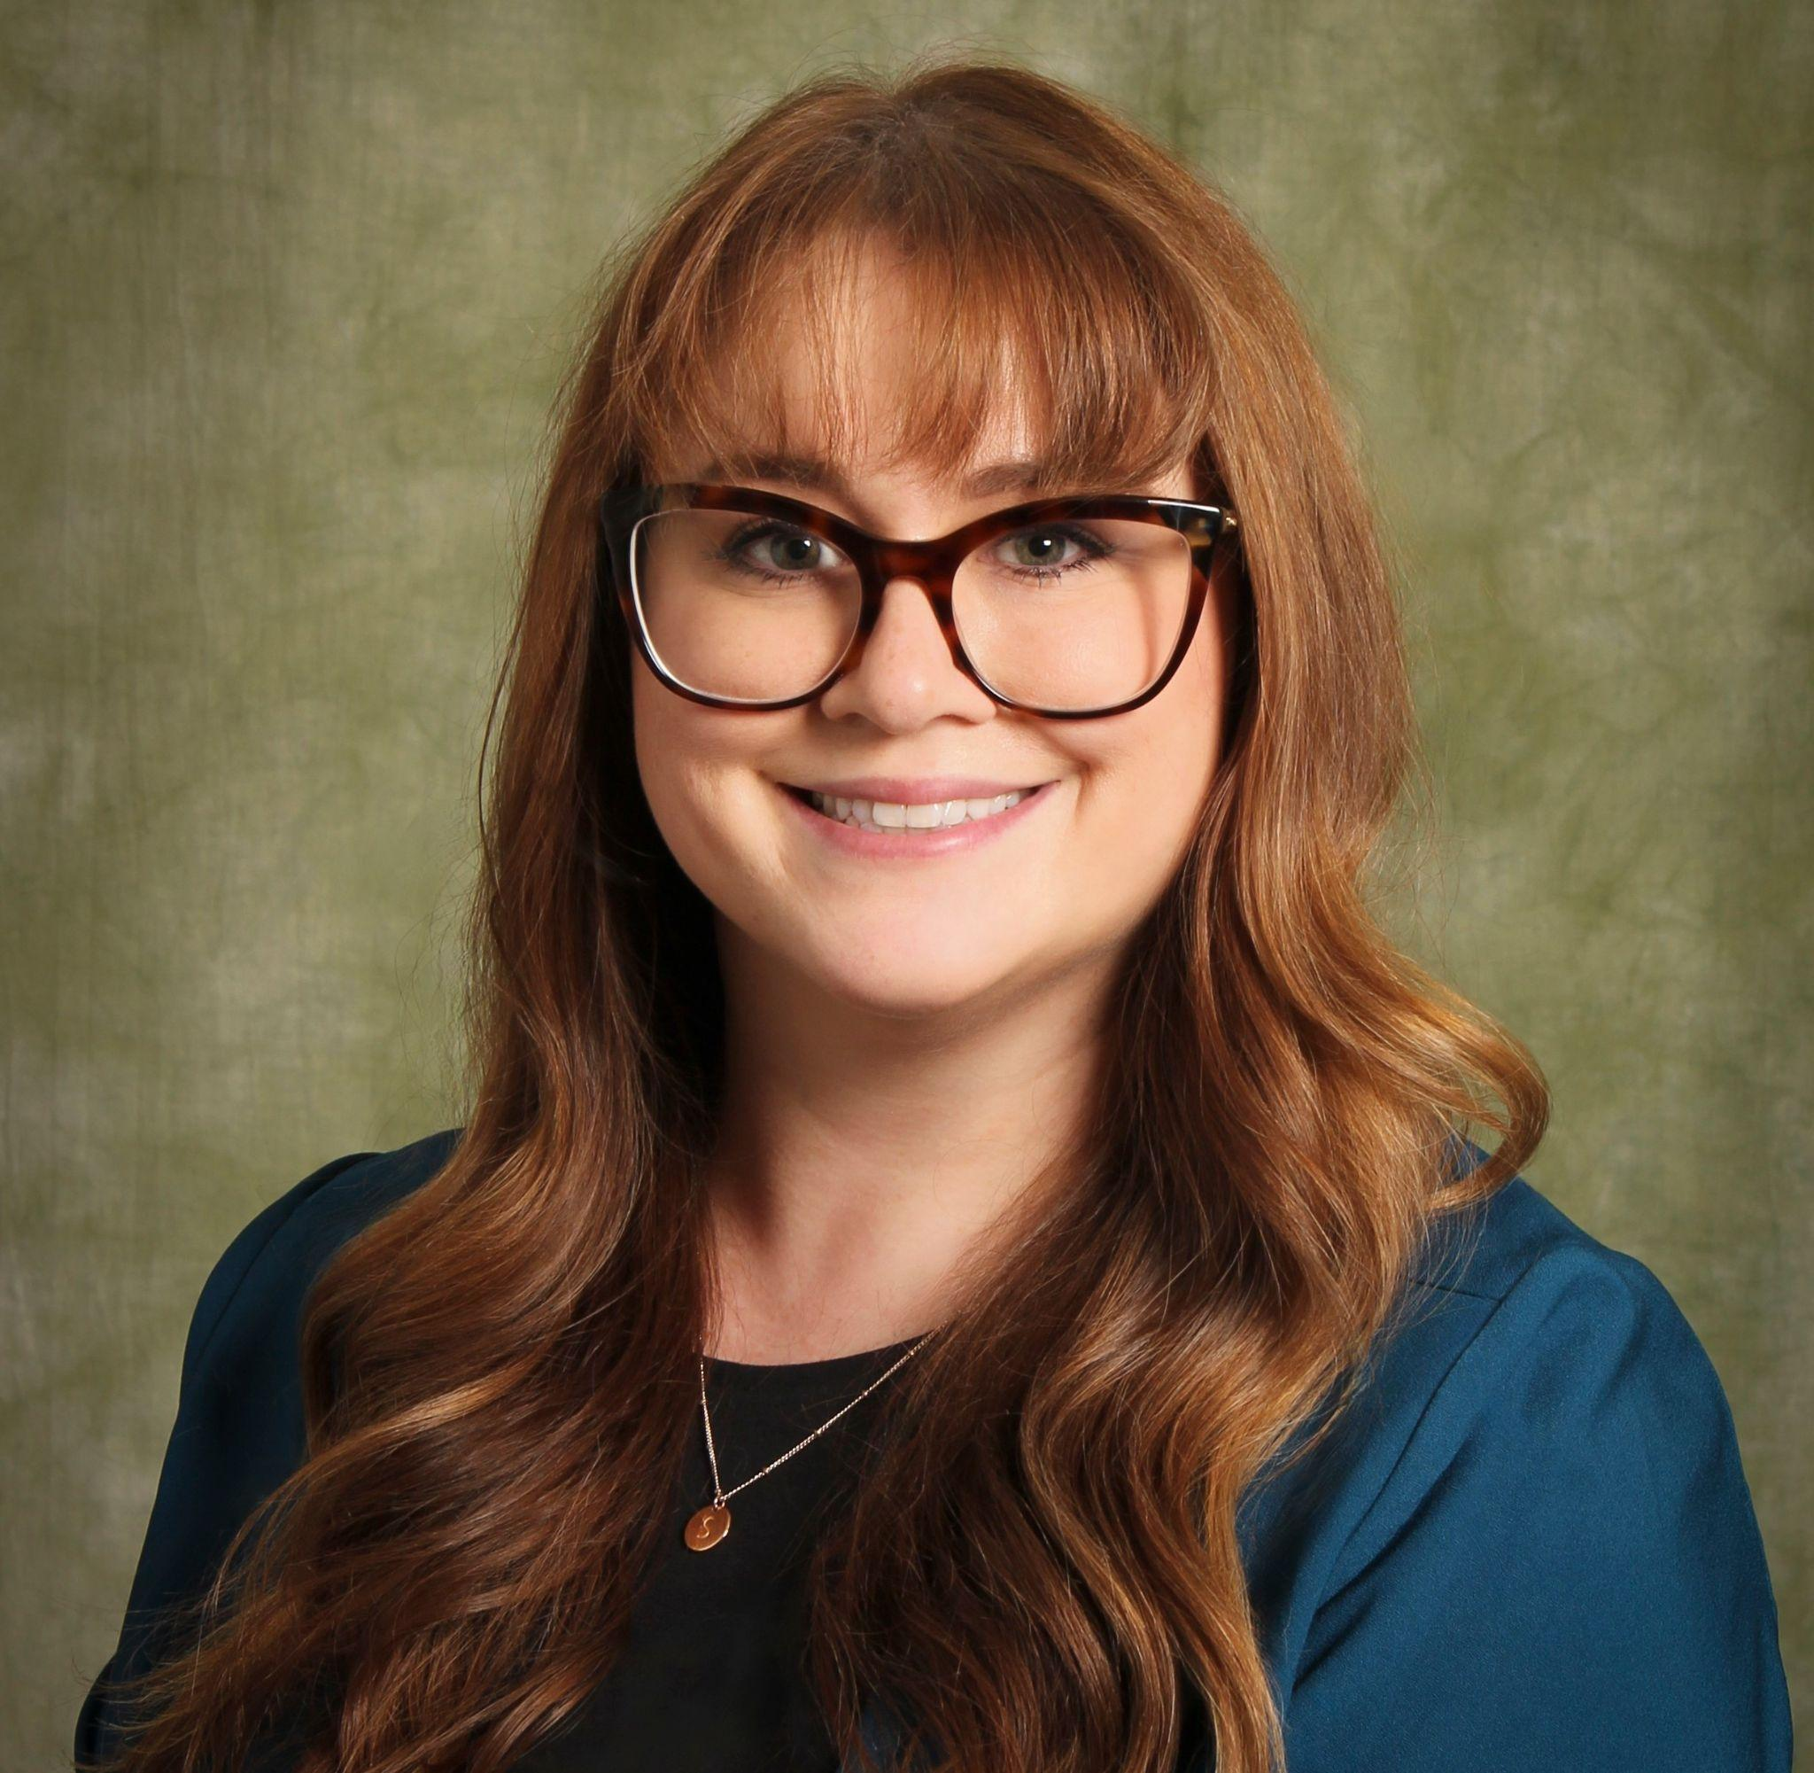
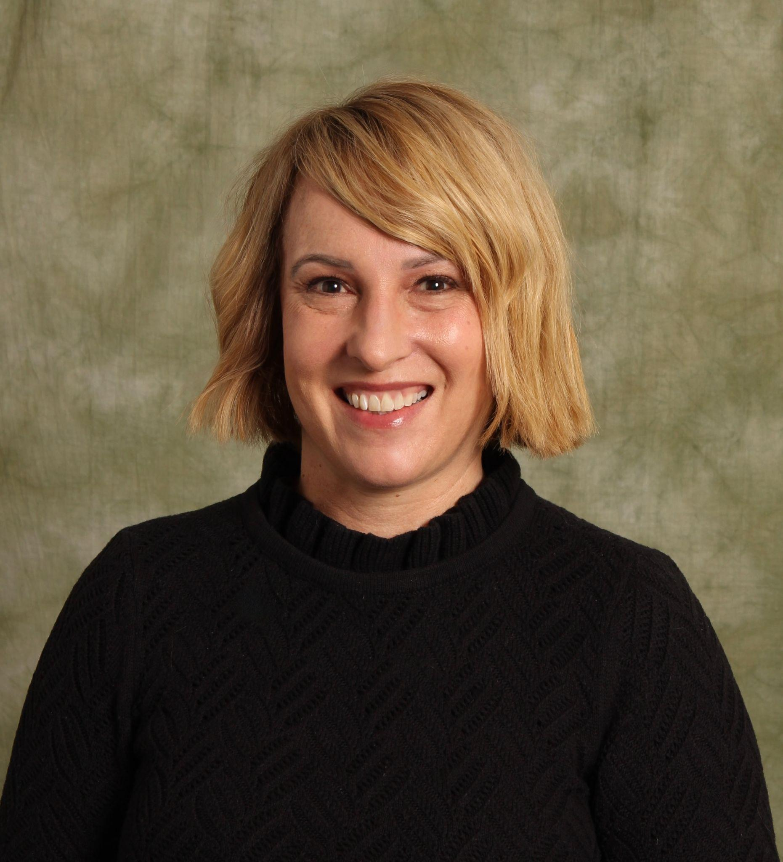
NYSED Community Schools Technical Assistance Centers
Central/Western CS TAC:
Housed at Binghamton University Community Schools
Providing guidance and training to new and established Community Schools.
Central/Western
Eastern
NYC
Casey Pulz
Director
Stacy Robitaille
Assistant Director
www.nyscommunityschools.org

Slide 4




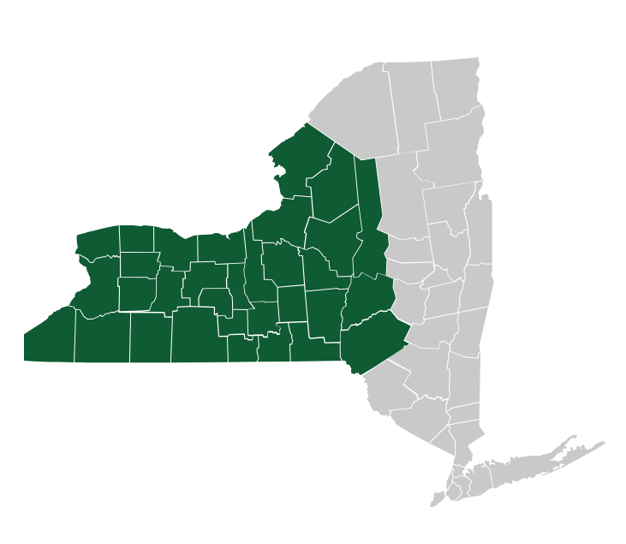


MENU OF SERVICES
Team Up with the C/W CS TAC to Strengthen Your Community School Efforts
www.nyscommunityschools.org
Made possible by:
1:1 Individualized Support and Facilitated Learning
Building capacity to support new, existing, and aspiring Community Schools
Community Schools 101
Framework and where to start
Family & Community Engagement
Best practices and key strategies
Needs Assessment
Guidance, tools, and implementation support
Sustainability & Leadership
Models and partnerships
Coordinator/Director Training
Onboarding and leadership skills
School Attendance
Community School approach and strategies
Join a Regional Community!
In-person/Virtual Professional Development and Communities of Practice
REGIONAL ROUNDTABLES
Request a facilitated conversation within your community
PROFESSIONAL DEVELOPMENT
Visit our website for in-person and virtual statewide learning opportunities
COMMUNITIES OF PRACTICE Join a virtual learning community, or ask to be connected with other districts
Contact us:
cstac@binghamton.edu
(607)777-9284
nyscommunityschools.org

Slide 5
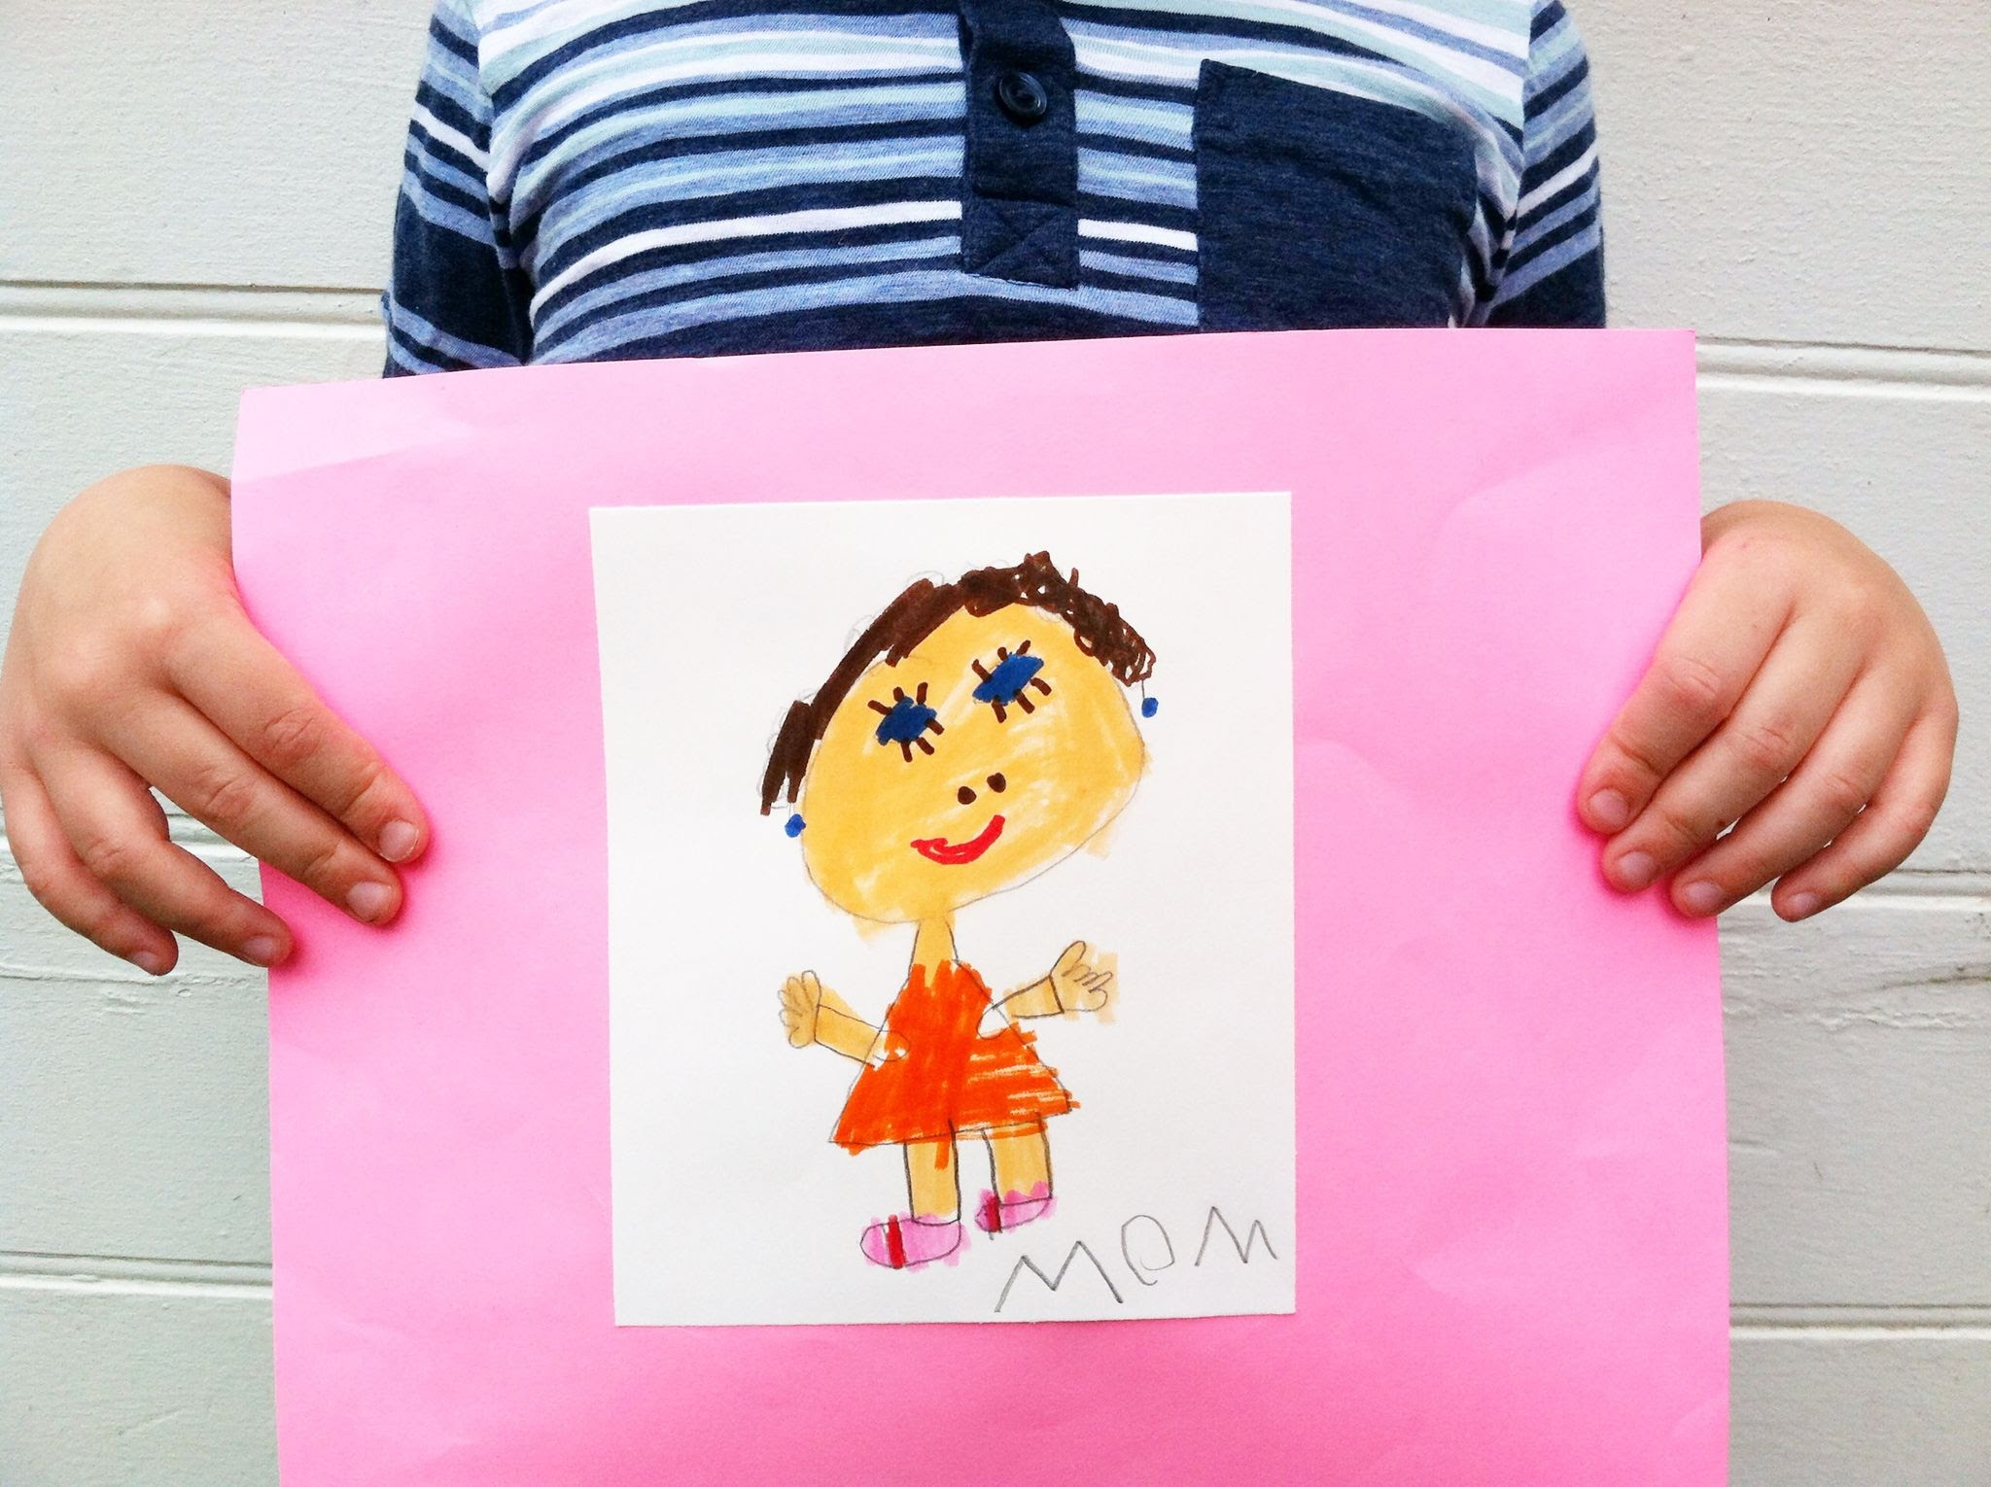
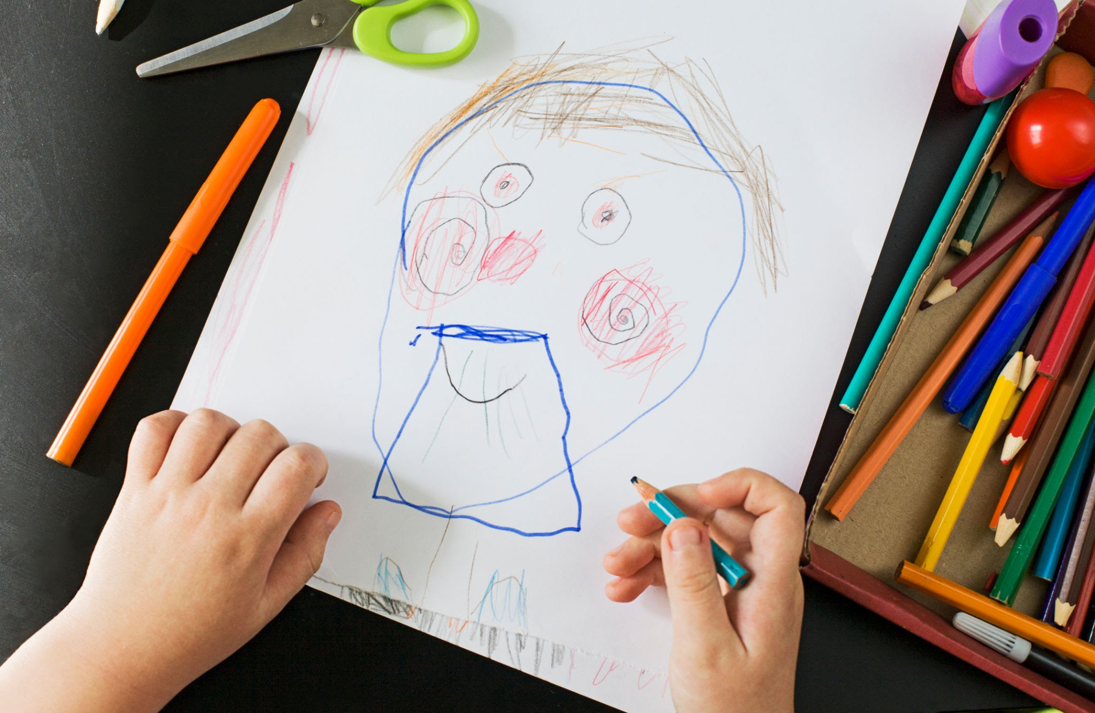
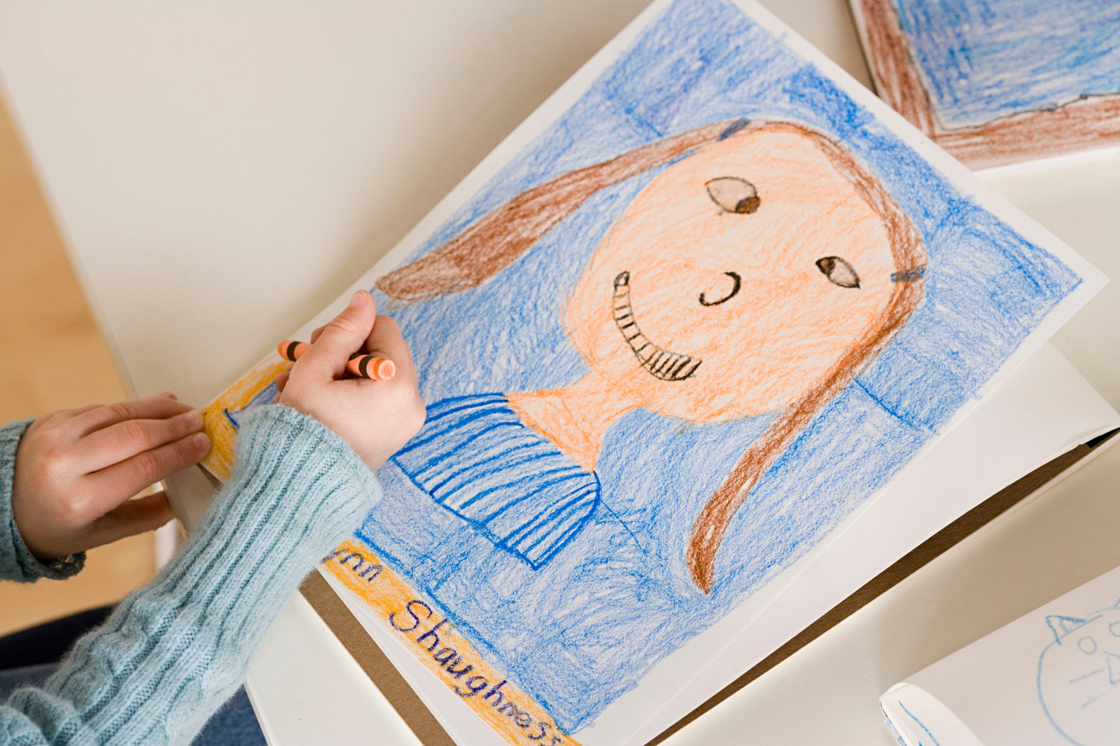
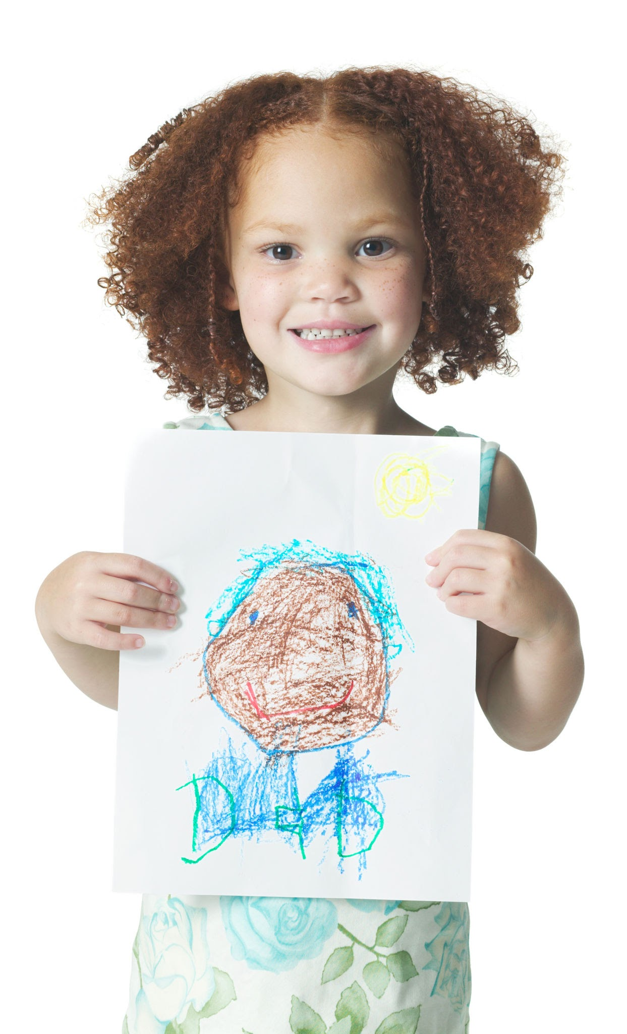

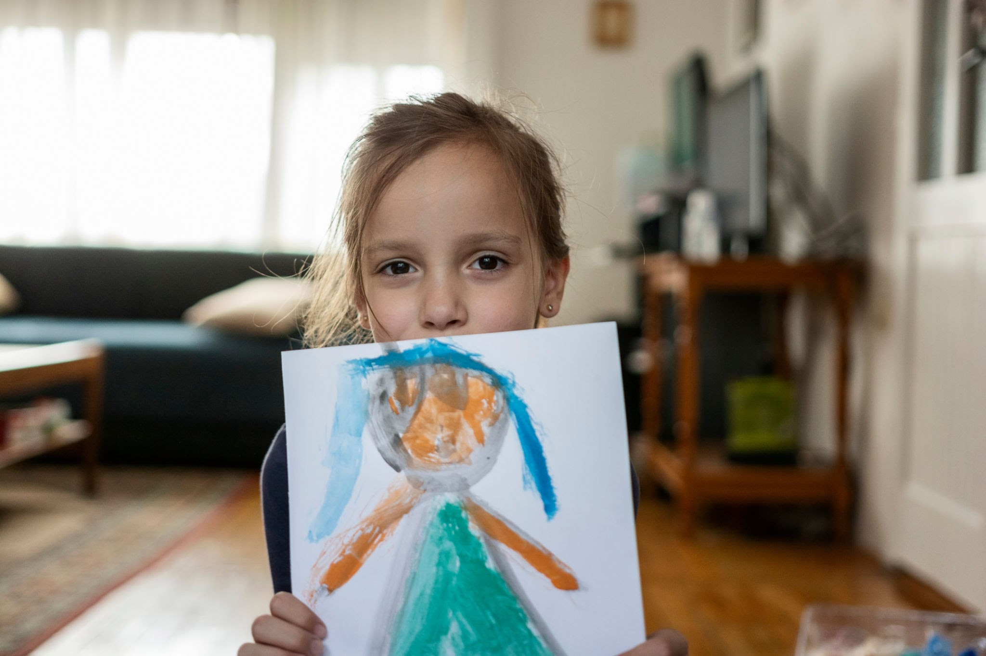
Draw Your Neighbor
https://www.ted.com/talks/tim_brown_tales_of_creativity_and_play
Notes:
You have 30 seconds to draw your neighbor….look at the person next to you and draw them.
Lots of laughter….some embarrassment……lots and lots of I’m sorry’s. This is what happens when you do this activity with adults
As we become adults- we fear being judged by our peers- this fear causes us to be conservative in our thinking and our ideas. We don’t want to share our ideas with others-
Do this with very young children and they will be proud to show off their masterpieces. We need YOU and all of your good ideas- After school care is HARD…you are superheroes the way you show up each day for kids. But the challenges can weigh us down- so today we are going to try and flip how we see challenges and find a couple helpful ways to get creative with problem solving.

Slide 6
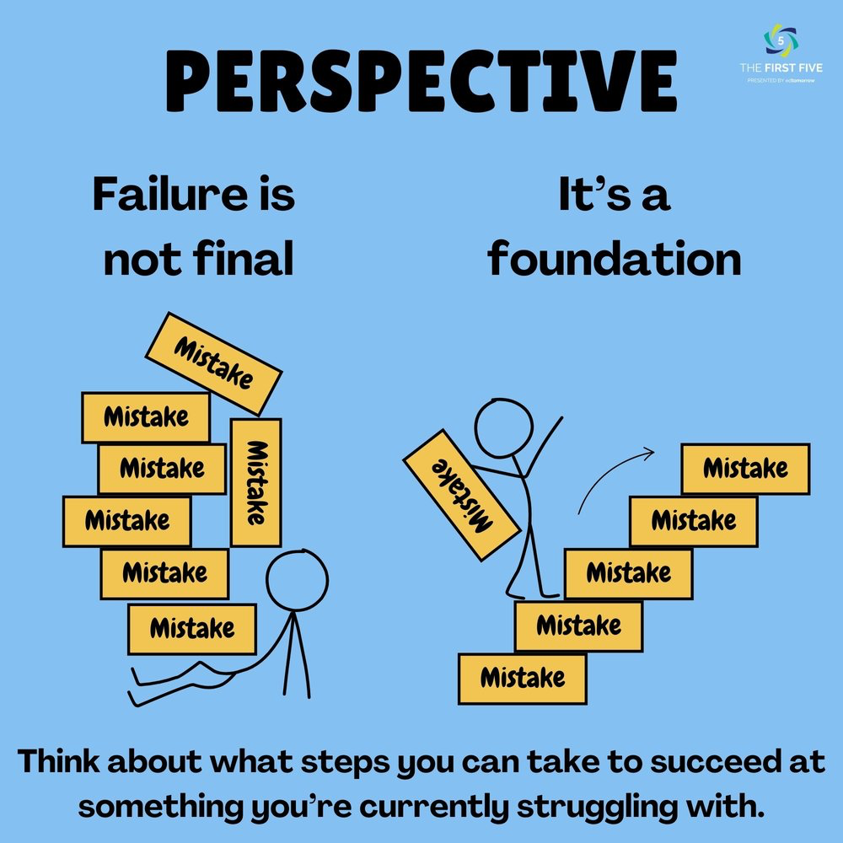
Agenda
Continuous Improvement = On-Going Problem Solving
Embracing the Challenges
Technical vs Adaptive Challenges
Creative Problem Solving Process( CPS)

Slide 7
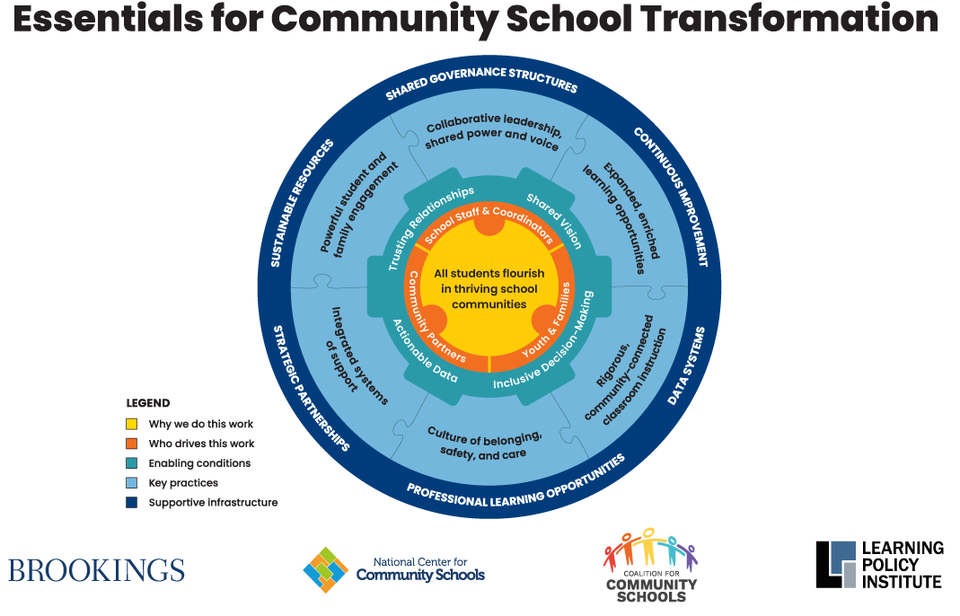
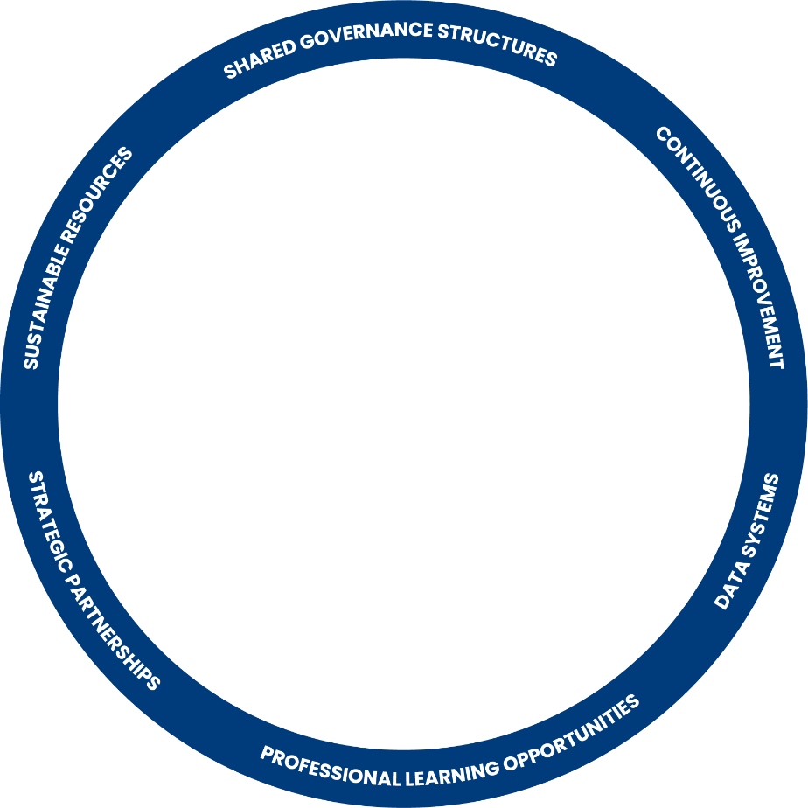
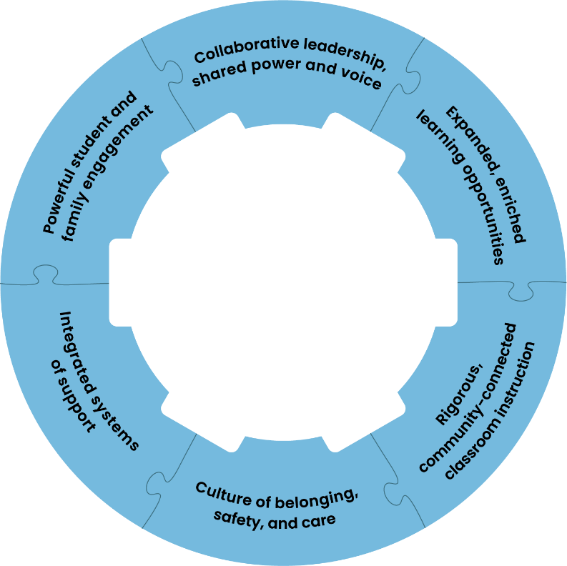
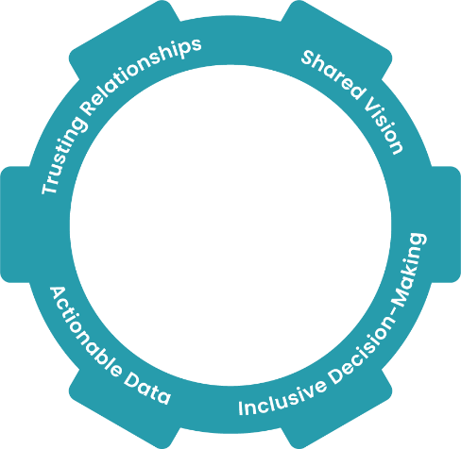
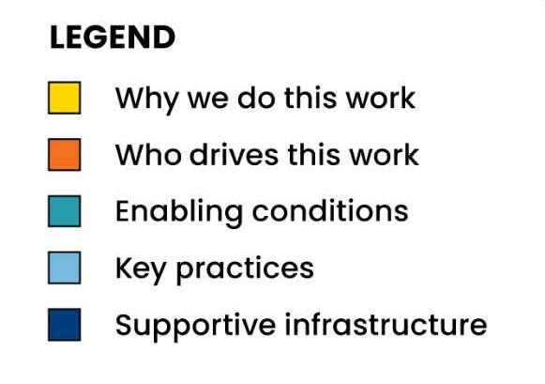
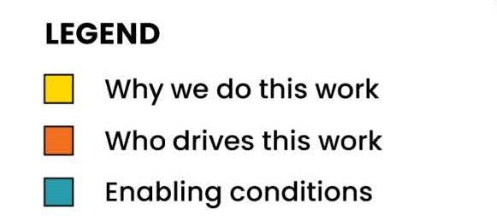
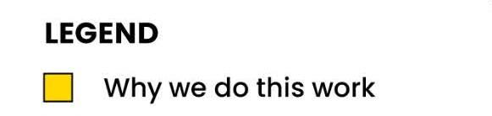
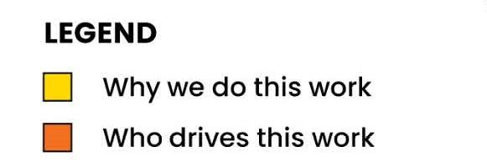
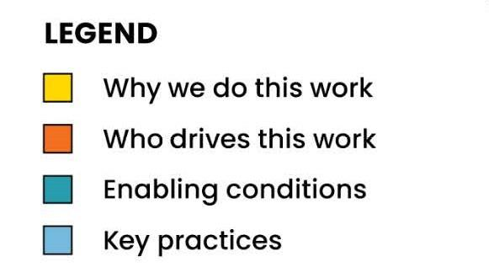

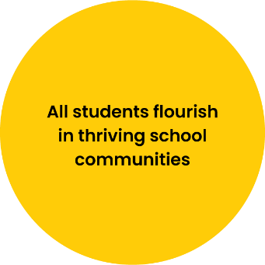
Notes:
Doing CS work is not easy, it is human work and therefore MESSY. We need to be adaptable, work through the problems and think with an open mind. Continuous improvement
🔄 Continuous Improvement = Ongoing Problem Solving
Continuous improvement is a philosophy (for Community Schools) that says:
“We’re never done growing. We can always do better—for students, families, and staff.”
Problem solving is the how—the structured process you use to understand what’s not working, experiment with solutions, and adapt.

Slide 8
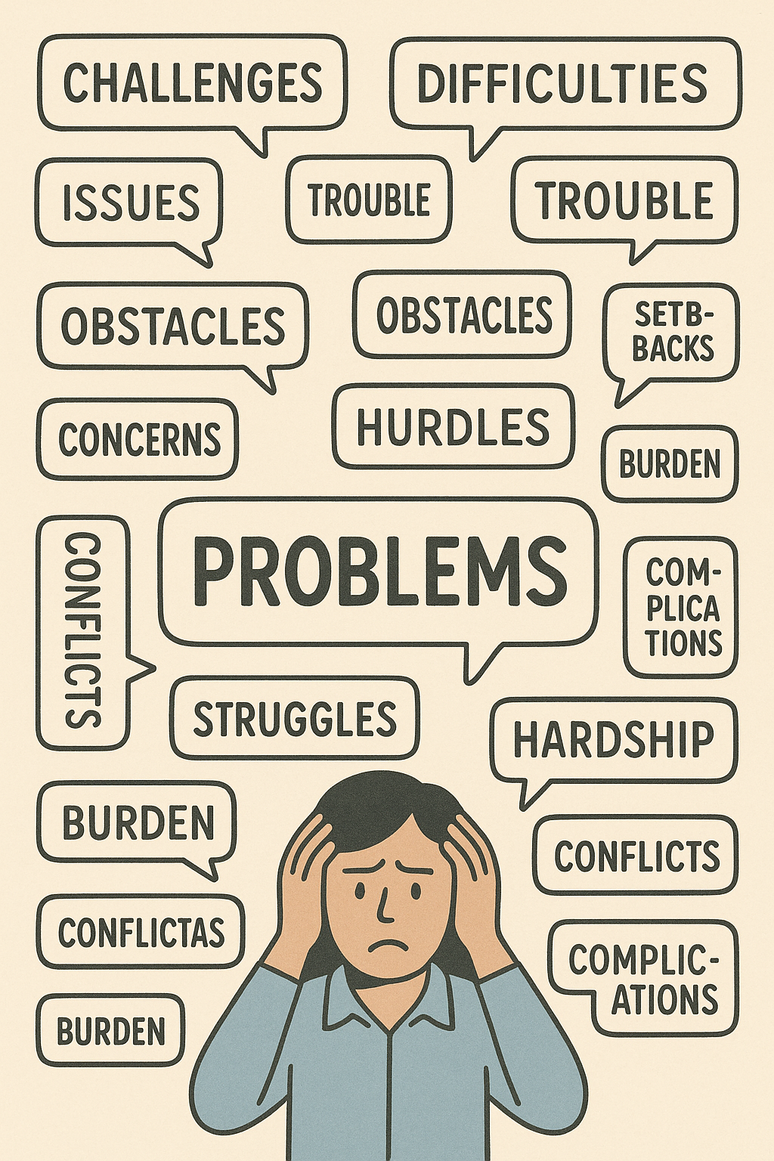
Continuous Improvement = On-Going Problem Solving
Continuous improvement is a philosophy in Community Schools that says:
“We’re never done growing. We can always do better—for students, families, and staff.”
Problem solving is the how—the structured process you use to understand what’s not working, experiment with solutions, and adapt.

Slide 9
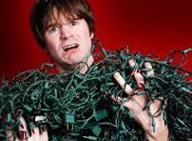
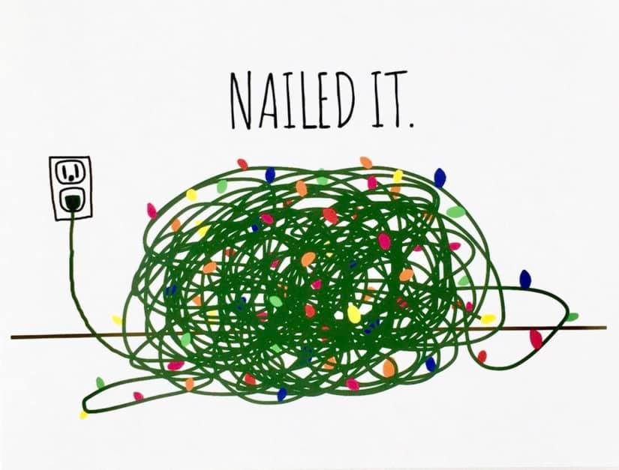
When Problems Overwhelm Us
We need to manage our desire to solve the problem too quickly!
Notes:
As humans we like problems that can be solved simply- the quick fix.

Slide 10
Technical Problems vs Adaptive Problems
Technical Problem | Adaptive Problem
Has a clear solution | No clear solution; requires learning
Solved by experts | Requires behavior and mindset change
Quick fix possible | Needs collaboration over time
e.g., Translate flyers | e.g., Build trust with multilingual families
- Ron Heifetz , The Practice of Adaptive Leadership (2009)

Slide 11
Adaptive Leadership Framework
Solving adaptive problems requires- learning, behavior change, and shared responsibility
“Get on the balcony” – Step back to see the bigger picture.
“Hold steady” – Don’t rush to fix; allow discomfort and dialogue.
“Regulate the heat” – Maintain productive levels of pressure to encourage growth.
“Give the work back” – Empower others to take ownership.
Ron Heifetz , The Practice of Adaptive Leadership (2009)
Notes:
Ron Heifetz is a renowned leadership expert, author, and educator known for developing the concept of adaptive leadership
Heifetz introduced the idea that some problems (adaptive problems) cannot be solved by authority or expertise alone—they require learning, behavior change, and shared responsibility
Heifetz is pronounced: HIGH-fetz
Key Contributions:
Adaptive Leadership Framework:
Heifetz introduced the idea that some problems (adaptive problems) cannot be solved by authority or expertise alone—they require learning, behavior change, and shared responsibility.
Core Concepts:
“Get on the balcony” – Step back to see the bigger picture.
“Hold steady” – Don’t rush to fix; allow discomfort and dialogue.
“Regulate the heat” – Maintain productive levels of pressure to encourage growth.
“Give the work back” – Empower others to take ownership.
Books:
Leadership Without Easy Answers (1994)
The Practice of Adaptive Leadership (2009, with Marty Linsky and Alexander Grashow)
Heifetz’s work is especially relevant to community school leaders tackling challenges like equity, engagement, and trust—problems that require adaptive, not just technical responses.
Would you like a slide summarizing Heifetz’s ideas and relevance to community schools?
You said:
how do you pronounce Heifetz
Heifetz is pronounced: HIGH-fetz
(Like "high" + "fetz" with a short “e” sound)

Slide 12
Get Creative to Solve Problems
Notes:
At the heart of Community Schools is - Relationship building and the ability to leverage everyones strengths- Staff, students, families, communities

Slide 13
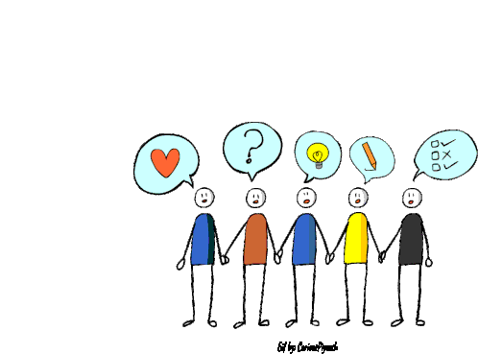
Get Creative with Problem Solving
The Creative Problem Solving Process begins with two assumptions-
EVERYONE is creative in some way
Creative skills can be learned and enhanced
Creative Education Foundation
Notes:
Do you believe you are creative? How can you use creativity to solve some of the challenges with after school programming? Share how you typically work to solve problems

Slide 14
Let’s Think
Divergent Thinking
Convergent Thinking
Generating lots of ideas
Brainstorming
Move past the obvious
Gives criteria to the brainstorming
Evaluate
Refine your ideas
What is CPS? | Creative Education Foundation
We need both types of thinking…… just like a car needs a gas pedal and a brake pedal to move in a new direction. You can’t press both at the same time.

Slide 15

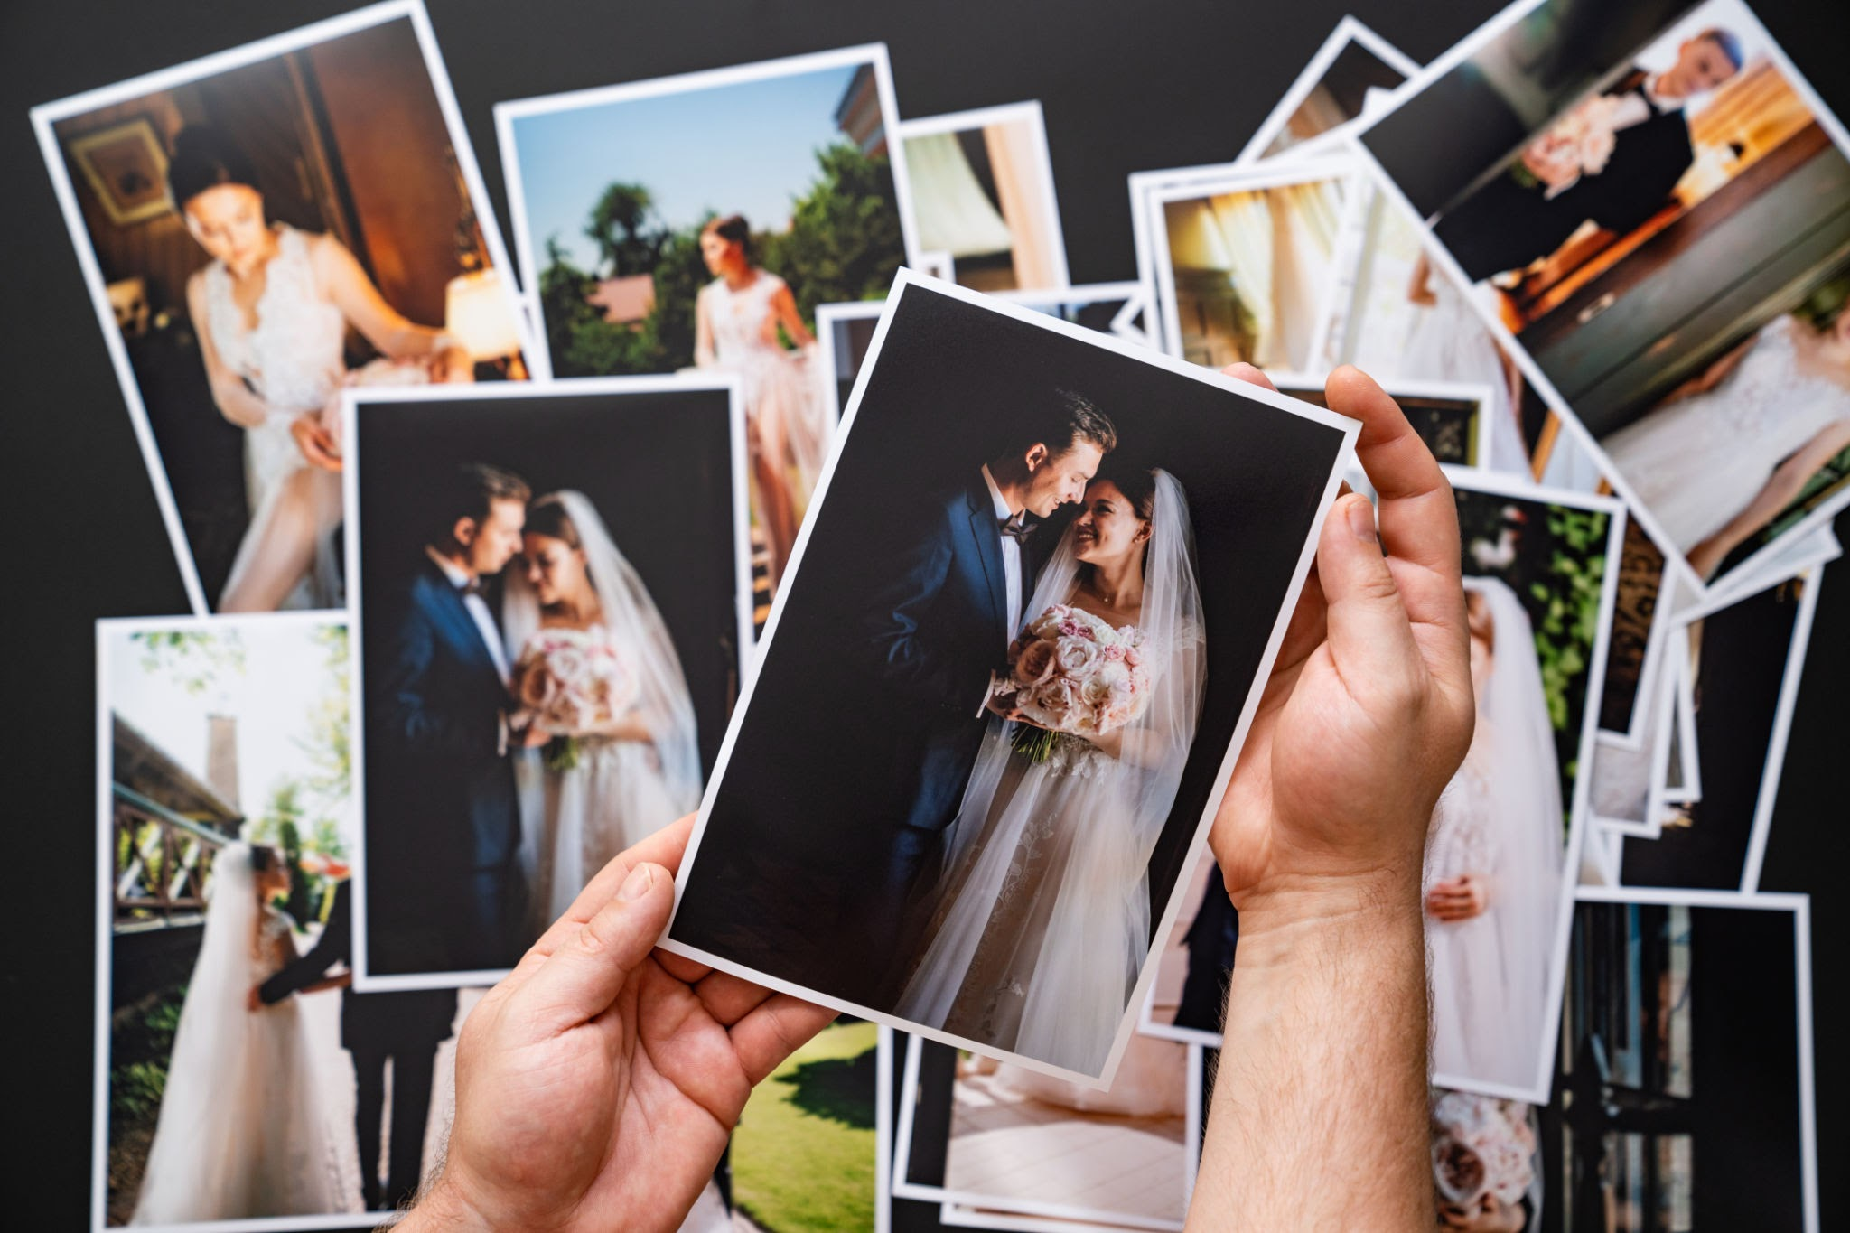
First Diverge, Then Converge
Divergent Thinking
Convergent Thinking
Take a lot of pics!
We don’t know which one will be the best one
No Judging!
Sort through your options!
Which ones do you like?
Make choices based on criteria

Slide 16
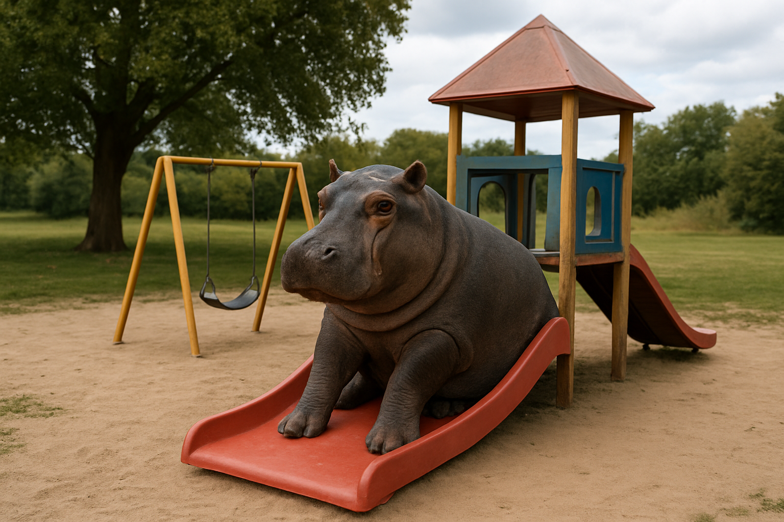
Divergent Thinking- Warm-up
Defer judgement
Strive for quantity
Seek wild and unusual ideas
Build on others ideas
What might be all the ways to get a hippopotamus out of a playground?
Notes:
Just like we practice to play sports, stretch before a long run or take many lesions to learn to play a musical instrument- being creative takes practice! Lets warm up our brains. Group think,turn and talk, brainstorming, forced connections
Ideas are the same. The more ideas you have to choose from,
the greater your chances of getting a good one.

Slide 17
The Creative Problem Solving Process

Slide 18
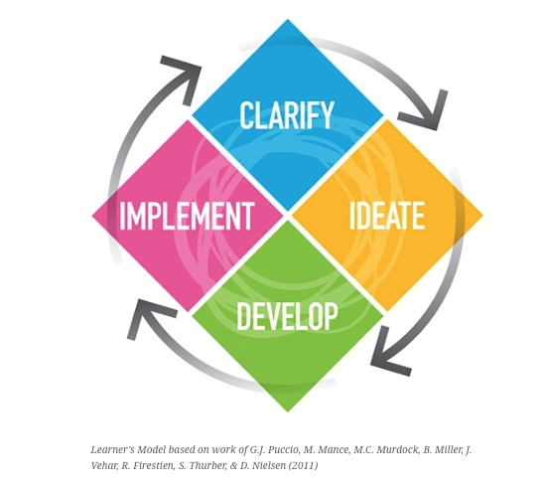
Creative Problem Solving Process
Steps to Follow:
Clarify the real problem(s).✓
Ideate without limits. Wild ideas welcome.✓
Develop 1–2 workable ideas into mini action plans.
(Optional) Prototype: Sketch or present your plan creatively.
Creative Education Foundation
Notes:
What is the real problem?

Slide 19
Clarify the Problem
GOAL: Understand the challenge fully before jumping into solutions
Steps:
Explore the situation ( what’s happening, what’s needed).
Identify the real problem ( not just the symptoms).
What’s the real question we are trying to answer?
The Five Whys

Slide 20



The Great Snack Stampede
At Jefferson After-School, the moment staff bring out snacks, chaos breaks loose. Kids rush to the snack table like it’s a Black Friday sale. Granola bars fly. Juice boxes burst. A third-grader is hoarding all the pretzels. Two staff members are frantically trying to restore order, but the line is more of a rugby scrum.
The director sighs and says: “Every day, snack time feels like running a food distribution center during an emergency. Why is this happening?”
Notes:
Using the Five Whys (Clarify Stage)
Here’s how you could guide them:
Why is snack time so chaotic?
Because kids all rush at once and fight over certain snacks.
Why do kids all rush at once?
Because they’re hungry and want to make sure they get their favorite snacks.
Why do they feel like they won’t get their favorite snacks?
Because supplies are limited, and the “good snacks” run out first.
Why are supplies limited / uneven?
Because the program doesn’t have a system for distributing snacks fairly or for ensuring enough of each type.
Why doesn’t the program have a system?
Because snack time has always been handled casually, without clear routines, expectations, or student input.

Slide 21
The Five Whys
“Every day, snack time feels like running a food distribution center during an emergency. Why is this happening?”
Let’s practice the FIVE WHYS….. What is the real problem to solve in this scenario? First WHY, then What’s stopping you?
The Five Whys
Notes:
Using the Five Whys (Clarify Stage)
Here’s how you could guide them:
Why is snack time so chaotic?
Because kids all rush at once and fight over certain snacks.
Why do kids all rush at once?
Because they’re hungry and want to make sure they get their favorite snacks.
Why do they feel like they won’t get their favorite snacks?
Because supplies are limited, and the “good snacks” run out first.
Why are supplies limited / uneven?
Because the program doesn’t have a system for distributing snacks fairly or for ensuring enough of each type.
Why doesn’t the program have a system?
Because snack time has always been handled casually, without clear routines, expectations, or student input.

Slide 22
Ideate Without Limits
GOAL: To think of as many ideas as possible
Steps:
Quantity over quality
Be playful, bold and imaginative
Tip: Encourage “yes, and…..” thinking and suspend judgement.
Notes:
Facilitator Prompts for Snack Time Scenario
Opening the discussion
“What feels most familiar about this exaggerated snack-time chaos?”
“If you were one of the staff in this situation, what would be running through your head?”
Exploring the first ‘Why’
“Why do you think the kids are rushing to the snack table?”
“Are they all motivated by the same reason, or could there be different reasons for different students?”
Digging into fairness and systems
“What does this tell us about routines, rules, and expectations at snack time?”
“What assumptions might the program be making about kids and snacks?”
Considering resources and structure
“Is the problem really about the snacks themselves, or about how they’re managed?”
“If snacks were unlimited, would the chaos go away — or would some issues remain?”
Connecting back to the Clarify stage
“Which of the ‘Whys’ feels closest to the real root of the problem?”
“What is this situation actually about — hunger, fairness, routines, or something else?”
“If we rephrased the problem in a neutral way, how would we state it?”

Slide 23

The More Ideas the Better
Generate first. Judge later.
Never do both at the same time.
Focus on YES and….rather than NO but…
Notes:
1. Frame the Challenge as a “How Might We…?” Question
Take the clarified root problem and turn it into a neutral, generative challenge statement. Example:
“How might we create snack routines that feel fair, calm, and enjoyable for students?”
“How might we give kids a voice in snack choices while keeping things orderly?”
👉 This helps practitioners focus on possibility rather than blame.
2. Use Quickfire Brainstorming (Divergent Thinking)
Give each person a stack of sticky notes or an online whiteboard space.
Set a timer for 5 minutes.
Ask them to write one idea per sticky note — the wilder, the better.
Encourage building off others’ ideas: “Yes, and…” instead of “Yes, but…”
Remind them: Quantity over quality at this stage.
Prompt lines you can use:
“If money and staff weren’t an issue, what would you try?”
“What’s the silliest idea you can come up with that might actually work?”
“Imagine the kids designed snack time themselves — what would it look like?”
3. Add a Twist with Brainwriting or Role-Storming
Brainwriting: Each person writes 2–3 ideas, then passes the paper to someone else who adds on or builds further.
Role-Storming: Ask them to ideate as if they were a hungry 3rd grader, a frustrated staff member, or even a pretzel (“What would the pretzel suggest?”). This keeps energy up and sparks fresh perspectives.
4. Cluster and Vote (Convergent Thinking)
Group similar ideas together (fairness systems, snack variety, student leadership, etc.).
Give everyone 3–5 dot stickers (or virtual votes) to place on their favorite/most promising ideas.
Discuss: “What do the top-voted ideas have in common?”
5. Transition to Next Steps
End by identifying a couple of small, testable changes that could be prototyped in real programs.
Example: Try a snack rotation chart for a week, or let one student be the “snack captain” each day.
Frame the Challenge as a “How Might We…?” Question
Take the clarified root problem and turn it into a neutral, generative challenge statement. Example:
“How might we create snack routines that feel fair, calm, and enjoyable for students?”
“How might we give kids a voice in snack choices while keeping things orderly?”
👉 This helps practitioners focus on possibility rather than blame.
2. Use Quickfire Brainstorming (Divergent Thinking)
Give each person a stack of sticky notes or an online whiteboard space.
Set a timer for 5 minutes.
Ask them to write one idea per sticky note — the wilder, the better.
Encourage building off others’ ideas: “Yes, and…” instead of “Yes, but…”
Remind them: Quantity over quality at this stage.
Prompt lines you can use:
“If money and staff weren’t an issue, what would you try?”
“What’s the silliest idea you can come up with that might actually work?”
“Imagine the kids designed snack time themselves — what would it look like?”
3. Add a Twist with Brainwriting or Role-Storming
Brainwriting: Each person writes 2–3 ideas, then passes the paper to someone else who adds on or builds further.
Role-Storming: Ask them to ideate as if they were a hungry 3rd grader, a frustrated staff member, or even a pretzel (“What would the pretzel suggest?”). This keeps energy up and sparks fresh perspectives.
4. Cluster and Vote (Convergent Thinking)
Group similar ideas together (fairness systems, snack variety, student leadership, etc.).
Give everyone 3–5 dot stickers (or virtual votes) to place on their favorite/most promising ideas.
Discuss: “What do the top-voted ideas have in common?”
5. Transition to Next Steps
End by identifying a couple of small, testable changes that could be prototyped in real programs.
Example: Try a snack rotation chart for a week, or let one student be the “snack captain” each day.
✨ This way, the group doesn’t just come up with abstract solutions — they leave with concrete, playful, and practical experiments to try.

Slide 24

Wild-But-Possible Snack Time Solutions
Let's hear those ideas….
Can you take any of your WILD ideas and turn them into usable solutions?
Notes:
🍎 Wild-but-Possible Snack Solutions Menu
Fairness Systems
Snack Lottery: Kids draw a number, and that’s their order in line. (Numbers switch daily so it feels fair.)
Rotating Snack Captain: Each day a different student helps distribute snacks.
Color-Coded Tickets: Kids get a ticket with their snack choice ahead of time, avoiding the rush.
Voice + Choice
Snack Council: A small group of students meets monthly to vote on snack options.
Snack Suggestion Box: Kids can “nominate” snacks they want to see.
Snack Menu Rotation: Weekly menu posted so kids know what’s coming and when.
Fun Routines
Snack Olympics: One silly mini-game (rock-paper-scissors, trivia, jump contest) decides who goes first.
Silent Snack Challenge: The group earns fun rewards if snack time is calm for X minutes.
Theme Days: “Fruit Friday,” “Pretzel Tuesday” — kids know what to expect.
Creative Distribution
Snack Stations: Instead of one table, create two or three “snack points” to reduce crowding.
Snack Cart: Staff (or student helpers) roll a cart around the room, serving kids where they are.
Pre-Bagged Grab-n-Go: Each snack is portioned ahead of time for faster distribution.
⚡ Facilitator Tips for Using This Menu
Present it as “just a jumpstart” if the group gets stuck.
Ask:
“Which of these feels most doable in your program?”
“How could you adapt one of these ideas to fit your kids?”
“What would make snack time feel calmer and more fun?”
Would you like me to design a one-page handout of this “Snack Solutions Menu” (with visuals/icons) that you could give participants as a brainstorming aid?
You said:
yes

Slide 25

Diverge Then Converge
Remember, not all your ideas are going to work.
Which ones have possibility? Which ones sparkle?
If you can’t think it, you can’t do it!
Notes:
🍎 Wild-but-Possible Snack Solutions Menu
Fairness Systems
Snack Lottery: Kids draw a number, and that’s their order in line. (Numbers switch daily so it feels fair.)
Rotating Snack Captain: Each day a different student helps distribute snacks.
Color-Coded Tickets: Kids get a ticket with their snack choice ahead of time, avoiding the rush.
Voice + Choice
Snack Council: A small group of students meets monthly to vote on snack options.
Snack Suggestion Box: Kids can “nominate” snacks they want to see.
Snack Menu Rotation: Weekly menu posted so kids know what’s coming and when.
Fun Routines
Snack Olympics: One silly mini-game (rock-paper-scissors, trivia, jump contest) decides who goes first.
Silent Snack Challenge: The group earns fun rewards if snack time is calm for X minutes.
Theme Days: “Fruit Friday,” “Pretzel Tuesday” — kids know what to expect.
Creative Distribution
Snack Stations: Instead of one table, create two or three “snack points” to reduce crowding.
Snack Cart: Staff (or student helpers) roll a cart around the room, serving kids where they are.
Pre-Bagged Grab-n-Go: Each snack is portioned ahead of time for faster distribution.
⚡ Facilitator Tips for Using This Menu
Present it as “just a jumpstart” if the group gets stuck.
Ask:
“Which of these feels most doable in your program?”
“How could you adapt one of these ideas to fit your kids?”
“What would make snack time feel calmer and more fun?”
Would you like me to design a one-page handout of this “Snack Solutions Menu” (with visuals/icons) that you could give participants as a brainstorming aid?
You said:
yes

Slide 26





Celebrate the WINS, Learn Through The Challenges
Notes:
This work is not easy- you must celebrate for yourself and each other- Who has a WIN to share….a problem that you helped work through or feel that you made some headway with?

Slide 27
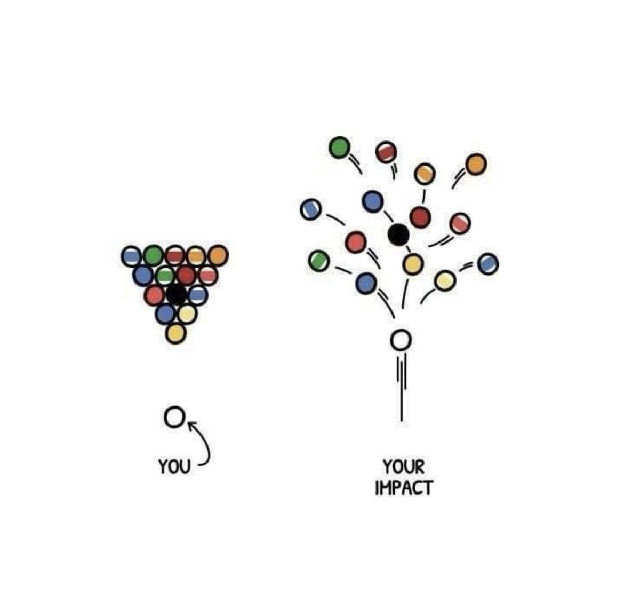
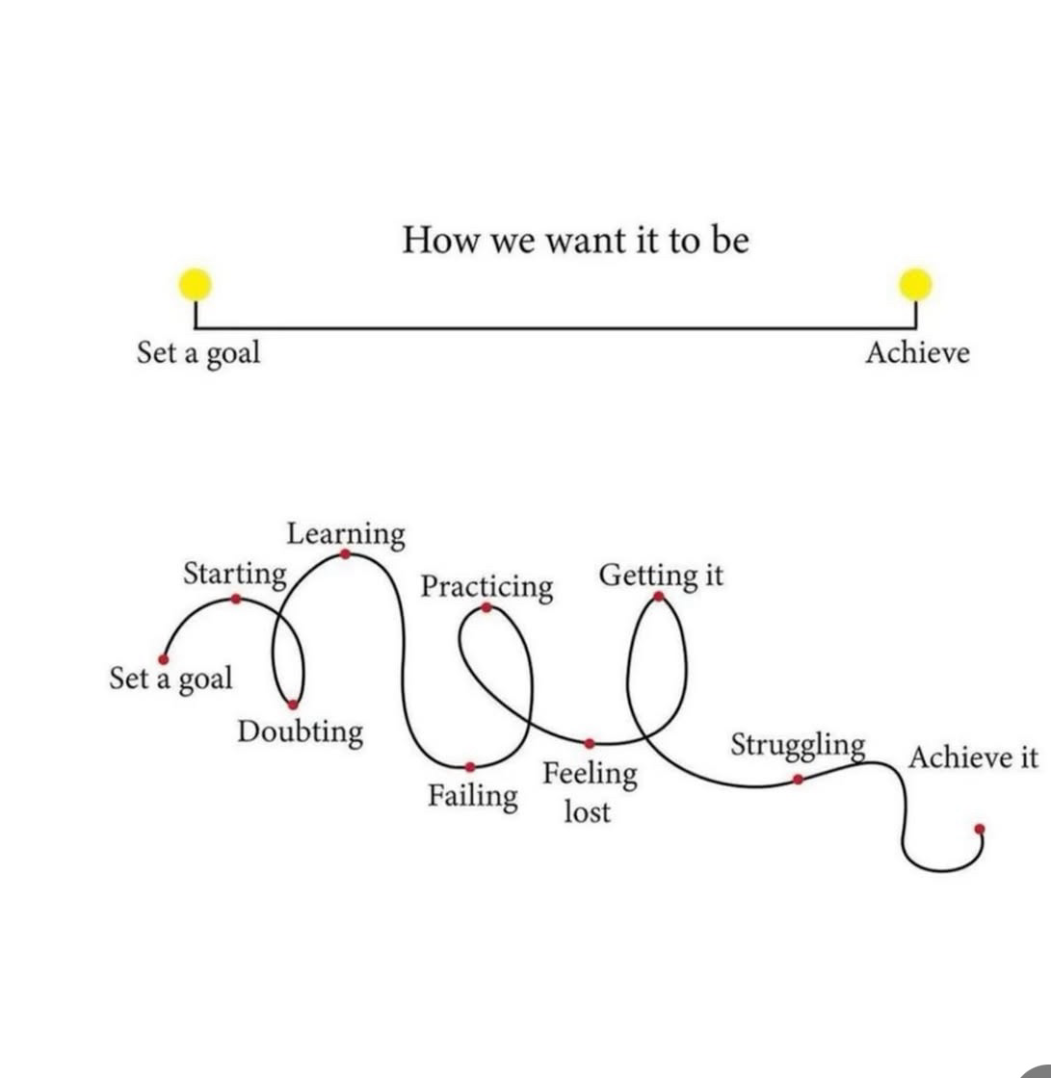
Final Thoughts
The JOY is in the JOURNEY!
YOU will make a difference…..
Notes:
Thank you for all you do!

Slide 28
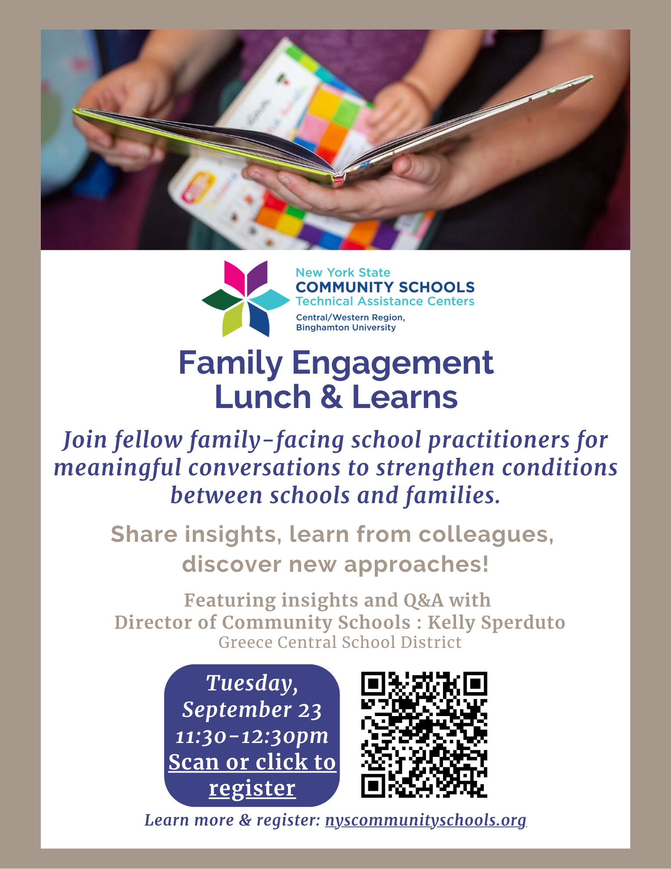

Upcoming Events
Visit our website to stay up to date on all upcoming events
nyscommunityschools.org
nyscommunityschools.org

Slide 29
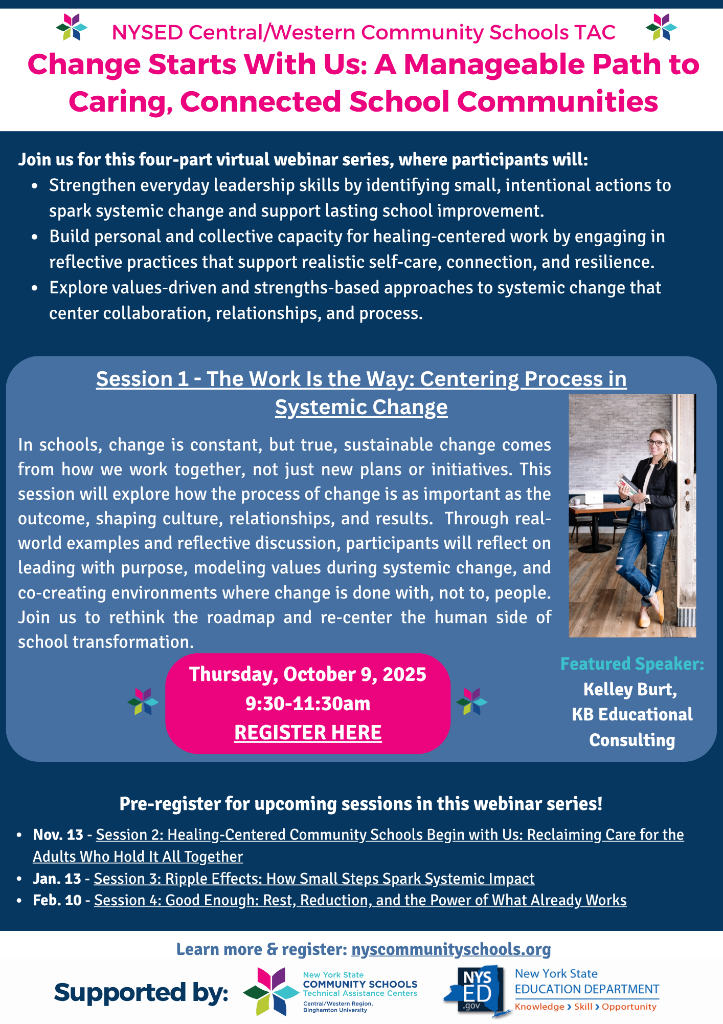
Virtual Webinars
Visit our website to stay up to date on all upcoming events
nyscommunityschools.org
Notes:
Casey

Slide 30
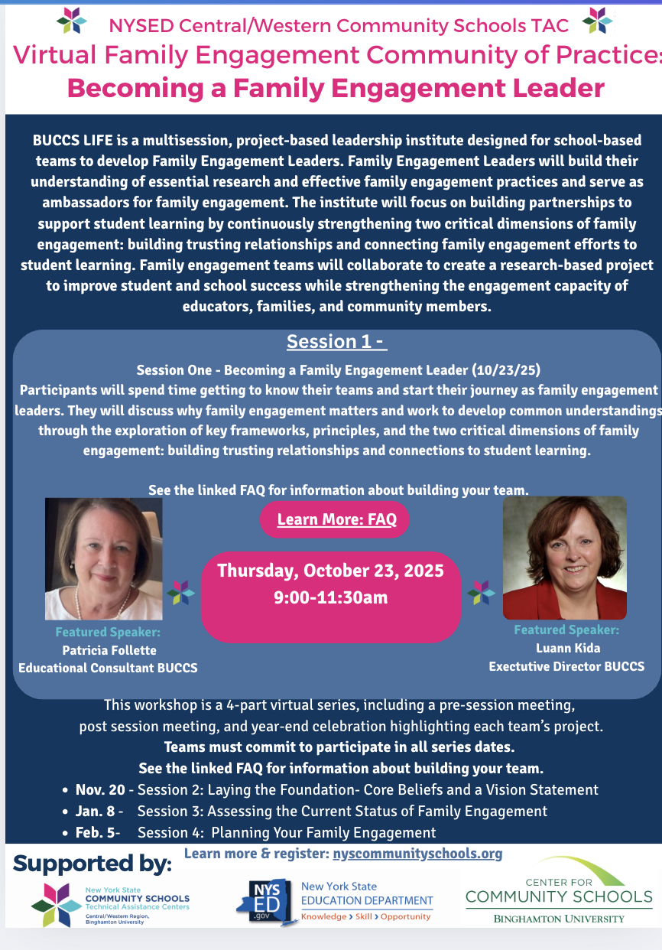
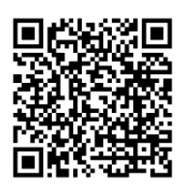
Upcoming Events-
BUCCS LIFE- Binghamton University Center for Community Schools
Leadership Institute for Family Engagement
Join us for a journey to become a family engagement leader. Teams of up to eight (8) people can participate from the same school.
Required participation includes:
At least TWO Parents, Family Members, or Caregivers (preferably not employed by the district)
At least TWO Teachers
School Principal
Community School Director/Coordinator (if school has this position)
A District-Level Administrator is required for the first session and celebration.
Space is limited to 10 teams!
nyscommunityschools.org

Slide 31


Thank you!
Casey Pulz, Director
clpulz@binghamton.edu
607-777-9245
Contact us!
1:1 individualized support
Tools/resources
Localized Communities of Practice
Stacy Robitaille, Assistant Director
srobitaille@binghamton.edu
607-777-9284
cstac@binghamton.edu
nyscommunityschools.org
Notes:
Casey

Slide 32
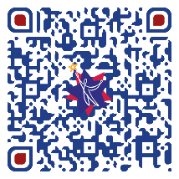
Survey
Please take a moment to take this brief survey.

