Slide 1

Creating Meaningful Lesson Plans​
Using the NYSED Template to Support High Quality Programming, Student Success, and School Alignment​

Slide 2
01
Workshop Objectives
By the end of today’s session, you will be able to:​
Write clear, complete lesson plans using the NYSED template​
Include strong learning objectives, SMART goals, aligned activities and assessments​
Integrate NYS Learning Standards and SEL Benchmarks (E-2 requirement)​
Embed Culturally Responsive-Sustaining practices (E-3 requirement)​
Confidently meet 21st CCLC expectations for 100% compliance​

Slide 3
On a scale of 1-10, how comfortable are you with creating a lesson plan?

Slide 4
02 Why Lesson Planning Matters
Lesson plans may not always be written by the facilitator​
They should be easy to follow regardless of who wrote it​
Lesson plans keep instruction organized, focused, and engaging for students​
Considers accommodations for different learning/teaching styles ​
Ensures learning objectives are clear and measurable for participants ​

Slide 5
03 Education Liaison – Supporting The Lesson Planning Process
Alignment Meetings​
• Meets with school-day teachers and administrators​
• Brings back key learning priorities and themes​
Standards & Goals Selection​
• Helps staff choose NYS Learning Standards and SEL Benchmarks​
• Ensures afterschool activities support school-day learning​
Lesson Plan Review & Feedback​
• Reviews draft lesson plans​
• Checks for clear objectives, standards alignment, and CR-S strategies​
• Ensures E-2 and E-3 compliance for SMV

Slide 6
03 Education Liaison – Supporting The Lesson Planning Process Part 2
Coaching & Professional Development​
• Offers modeling and tips for writing effective, inclusive plans​
• Supports culturally responsive teaching practices​
Observations & Reflection​
• Visits sessions to see plans in action​
• Provides supportive, constructive feedback

Slide 7
04 21ST CLLC Require That All Lesson Plans Have The Following Components:
NYS Learning Standards
Social & Emotional Learning Benchmarks
Lesson Objectives
CRS Education

Slide 8
05 Part 1: Setting the Stage
1. Set the Stage​
Explain the objective in clear, age-appropriate language​
Connect the lesson to students’ experiences and interests​
2. Choose Your Introduction Method​
Vocabulary words and definitions​
Movie clips or short videos​
News articles or current events​
Images or props​
Personal stories or scenarios​

Slide 9
05 Part 2: Making it Relevant
3. Make It Relevant and Engaging​
Ask questions to activate prior knowledge​
Encourage predictions or opinions​
Invite student voice and choice​
4. Be Culturally Responsive​
Use examples that reflect students’ cultures and communities​
Include multiple languages or visuals as needed​​

Slide 10

06 Lesson Plan Components
What is the topic of the lesson?​
What do I want students to learn?​
What do I want them to understand and be able to demonstrate?
1. Lesson Objectives​​

Slide 11
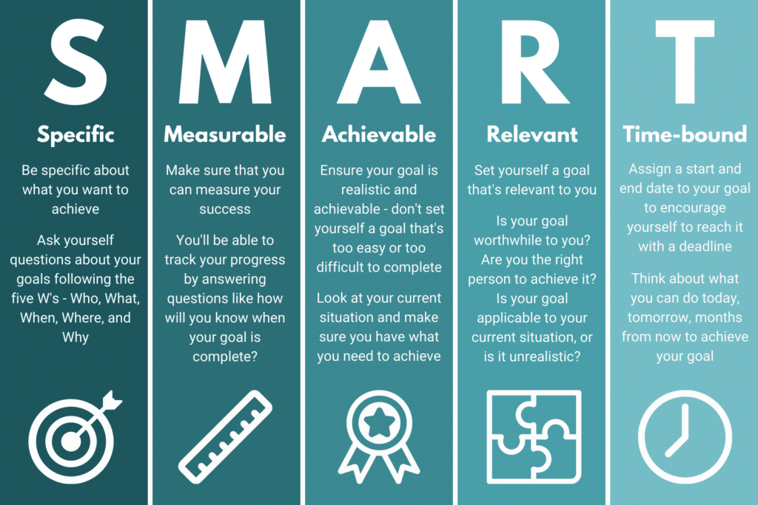

Slide 12
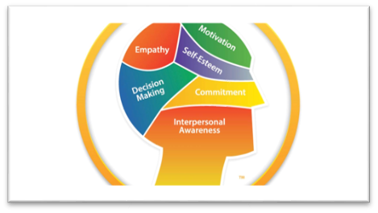
2. SEL Benchmarks​​
Self-Awareness​​
Self- Management​​
Social Awareness​​
Relationships Skills​​
Responsible Decision Making​​
​​

Slide 13
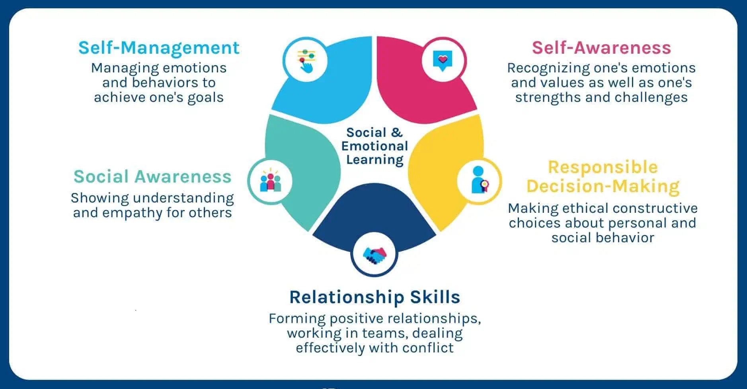

Slide 14
Incorporating SEL Into Activities
SEL practices help students foster skills in intrapersonal & interpersonal relationships, as well as decision making. SEL research also suggests that benchmarks may increase a student's likelihood of being more empowered learners and to be more connected in school.​
Read through the SEL benchmarks and identify what goal you would like to achieve through your lesson and what might also work well with the intended activity. (You will notice there are different goal marks for different grade levels.)​
Incorporate these goals into the directions or in discussion.​

Slide 15
Scenario
You're teaching a social studies lesson for Native American Heritage Month about the Three Sisters. You have an activity where the students get to plant their own seeds in a garden and harvest later in the year. What kind of questions would you ask during and after the lesson that incorporates the below SEL benchmarks?
“2A.1a. Recognize that others may experience situations differently from them.” is the benchmark for this goal for Early elementary grades k-2.
“2A.4a. Reflect on the similarities and differences between their own perspectives and the perspectives of others, including those from different identity groups” is the benchmark for early High School grades 9-10.

Slide 16
Scenario
Can you think of any differences between how you plant seeds and how the Native Americans planted seeds? (Tools, techniques, etc.) (9-10)
What does the “three sisters” mean to you? What do you think it meant for the Native Americans? (9-10)
Do you think the Native Americans ate more vegetables & fruits than you do? Why or why not? (K-2)

Slide 17

3. NYS Learning Standards
21st CCLC programs are required to adhere to the NYS learning standards​
Learning standards articulate what all students should know and be able to do as a result of instruction in subject area and grade level​
All NYS learning standards can be found at https://www.nysed.gov/standards-instruction

Slide 18
NYS Learning Standard Examples
3-ESS2-1: Represent data in tables and graphical displays to describe typical weather conditions expected during a particular season. (Subject area - Science, Grade level - Elementary 3-5)​
MS-LS1-5: Construct a scientific explanation based on evidence for how environmental and genetic factors influence the growth of organisms. (Subject area - Science, Grade level - Middle School 6-8)​
NY-6.RP.1: Understand the concept of a ratio and use ratio language to describe a ratio relationship between two quantities.(Subject area - Math, Grade level - 6th grade)​
NY-1.OA.3: Apply properties of operations as strategies to add and subtract. (Subject area - Math, Grade level - 1st grade)​
MU:Cr1.1.6 a: Generate rhythmic and melodic ideas over given harmonic accompaniments within AB and ABA forms, and Identify connection to purpose and context (Subject area - Music, Grade level - 5th grade)​

Slide 19

Culturally Responsive-Sustaining Education
CR-S Education is grounded in a cultural view of learning and human development in which multiple expressions of diversity are recognized and regarded as assets for teaching and learning.
Lesson plans & activities that are intentionally designed to include student voice and choice.

Slide 20
Culturally Responsive-Sustaining Education Continued
4 principals of CR-S education
  Welcoming and Affirming Environment
  High Expectations and rigorous instruction
  Inclusive curriculum and assessment
  Ongoing professional learning and support

Slide 21

Examples of how CR-S Education can be addressed in Lesson Plans or Activities?
Type in chat or speak about any examples you have

Slide 22
Other Key Components Of A Lesson Plan:
Materials
Adaptations
Activities
Assessment​
Time
Requirements
Dor

Slide 23
06
Activities
Josh

Slide 24

Activities
Learning activities are tasks or exercises designed to engage students, build knowledge, and promote understanding of a subject.​
Consider activities as the "backbone" of any great lesson plan.​
Ask yourself: What activities are being done in this lesson? A craft? An experiment? A game?​
  Keep in mind that students learn in different ways and activities can offer a fun hands on approach to learning.
  ​
  When choosing the activity keep in mind what grade you are serving, an activity for K and 1st grade would be vastly different for 5th and 6th grade.

Slide 25
Required Materials
Required materials are the resources and supplies needed to implement a lesson and engage students in learning activities. These materials can include textbooks, handouts, visual aids, technology, and various manipulatives or supplies depending on the lesson objectives and activities.
Different materials Include but are not limited to: Print materials (textbooks), visual aids (posters), supplies (markers), technology (laptops) and other resources.
Considerations when choosing materials:
  Relevance to learning objectives
  Student needs
  Engagement and motivation
  Accessibility
  Cost and availability
Alex

Slide 26
07
Timing & Adaptation

Slide 27
Timing is Everything!
Consider how long of a time frame you have for your lesson. How long does it take to complete the lesson from start to finish? How long do you have to teach the lesson?
  It’s best to run through a lesson before you get in front of the students, this gives you an idea of how long you should spend on different parts of your lesson.
  Also consider when you try an activity that students may need more time than what you needed.

Slide 28
Adapt!
Know your audience. You may need to adapt your lesson or even your materials depending on the population you are teaching. Below are a few examples to take into consideration for your lesson.
  Dual language instruction
    Do you need translations of materials to more languages? Is there a bilingual staff available to translate?
  Age range
    Do you need to adapt to a younger or older group then the lesson is intended?
    I recommend having multiple variations of a lesson to account for age differences.
  Cultural background
    Not everyone has the same lived experience and may be unfamiliar with different vocabulary, equipment, expectations, etc.
  Special populations
    Can everyone in the group participate in the activity? What accommodations need to be made if the answer is no?
    Are there different activities to sub that are more accommodating? It is recommended to have a few different activities that can work with the lesson.
    Do you have equipment/resources for students of different abilities? Examples- Fidget toys, noise canceling headphones, 1:1 aides, interpreters, etc.

Slide 29
Wrap up
How Do You Build a Lesson Plan?
Objective: What do you want students to learn?
NYS Learning Standard: How will you align to school-day learning?
SEL Benchmark: Which skill are you developing?
Activities: What will students do?
CR-S Strategies: How will you include student voice or culture?
Timing & adapting: How does timing and adapting help flow?

Slide 30
Important Links
NYSED’s Standards: https://www.nysed.gov/standards-instruction
SEL Benchmarks: https://www.nysed.gov/student-support-services/sel
Culturally Responsive & Sustaining Practices: https://www.nysed.gov/crs
Educational Liaison Resource Guide: https://www.nys21cclc.org/_files/ugd/2eca12_2cc4e57c900f4faaac37975362377267.pdf

Slide 31
Thanks!
Any questions?
Rest of State Resource Center:
ny21cclc@binghamton.edu
New York City Resource Center:
TARCNYC@schools.nyc.gov.

