Slide 1



Starting off Strong: Promising Practices to Kick Off a New Year
Notes:
This session will highlight insights to enhance participant engagement, including culturally-responsive activity planning, tips for field trips, meaningful feedback pathways, and more. Participants will have the opportunity to share curriculum and program ideas with peers, and leave with strategies to enhance their programs.

Slide 2
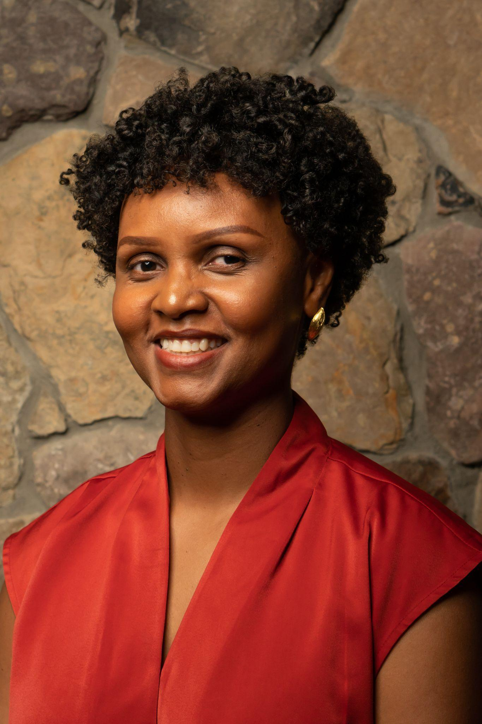

About Darise
Senior Director, Program Narratives
18 years teaching and nonprofit experience
Self care -> naps
Bronx born and raised
Former Press & Sun-Bulletin intern

Slide 3
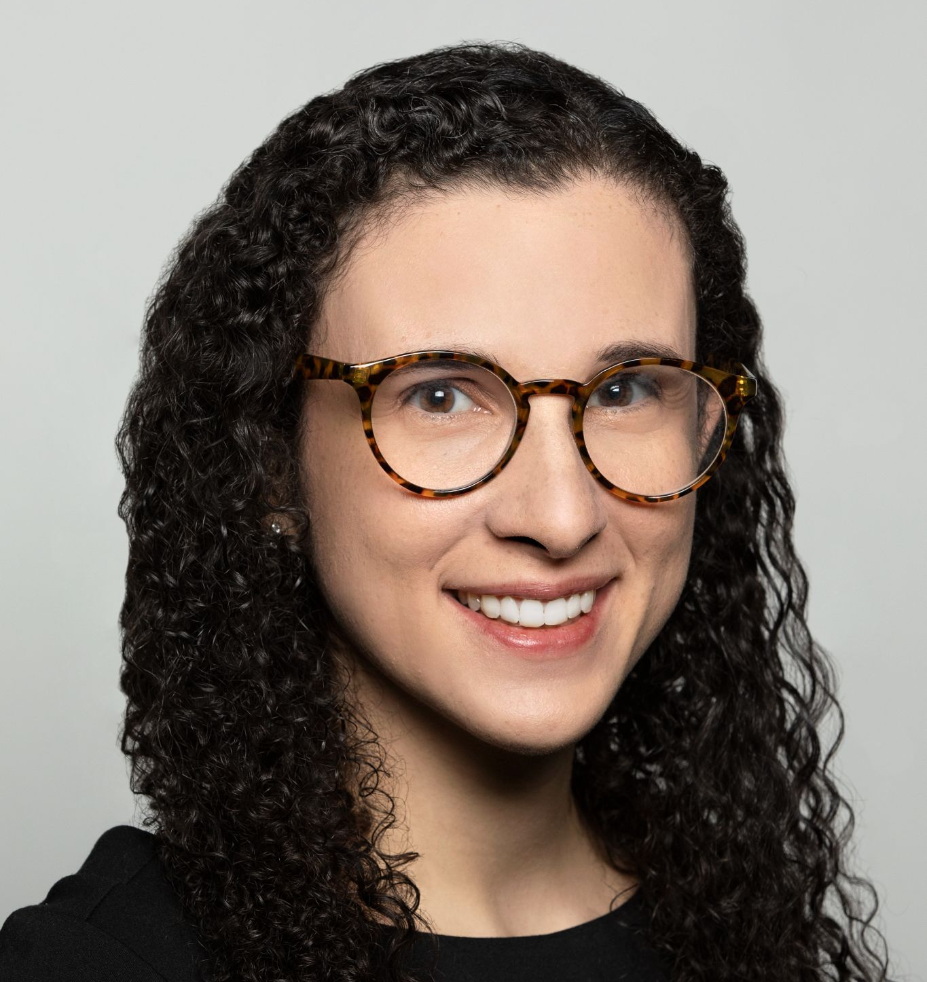
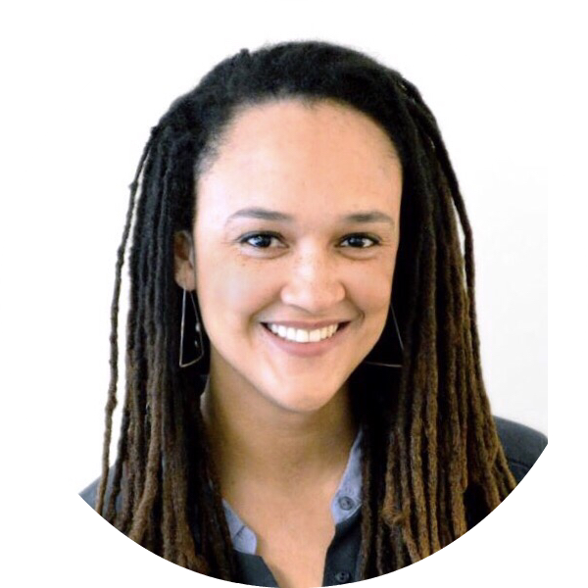


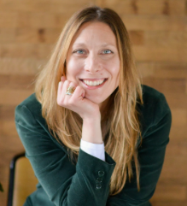

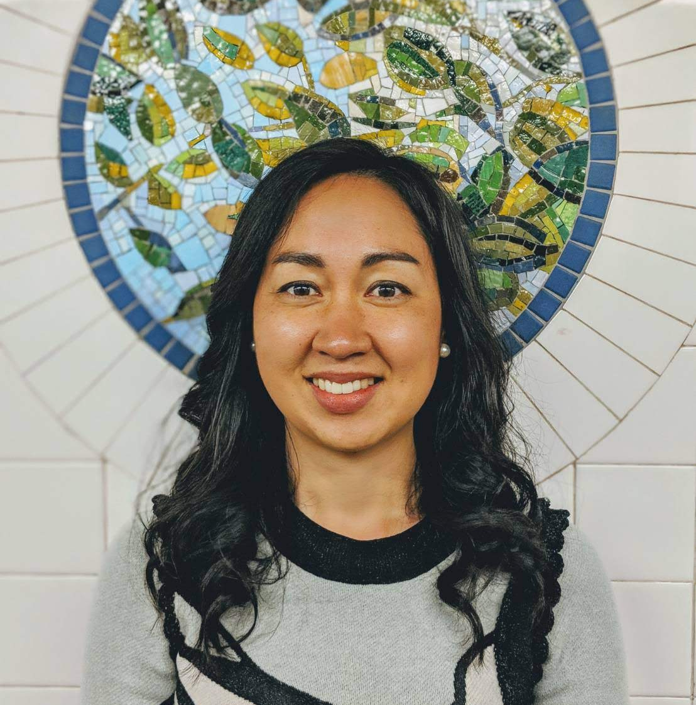
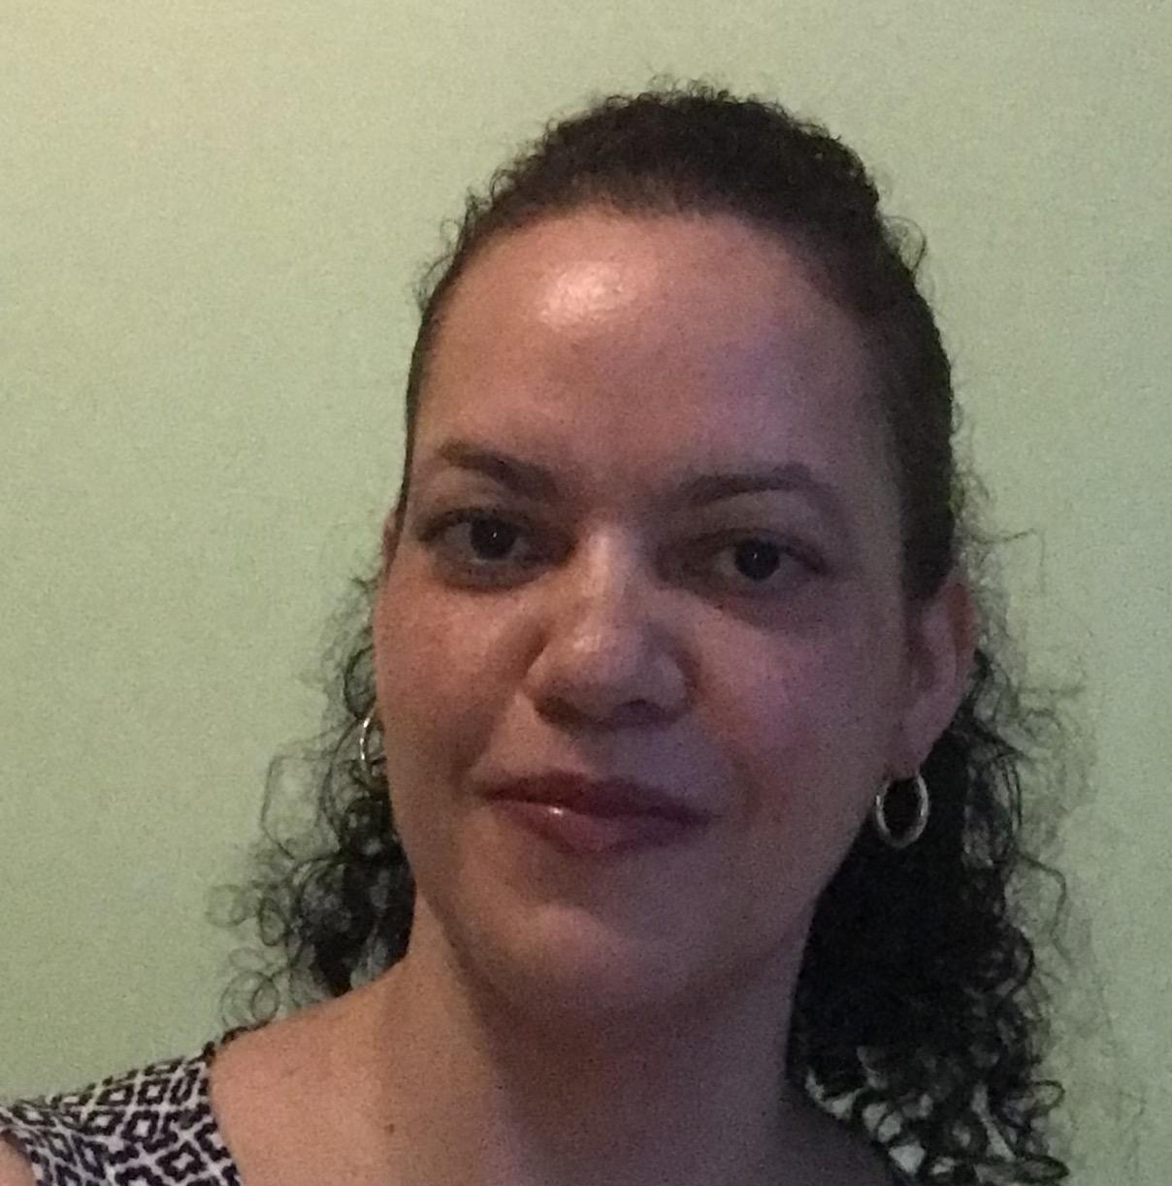
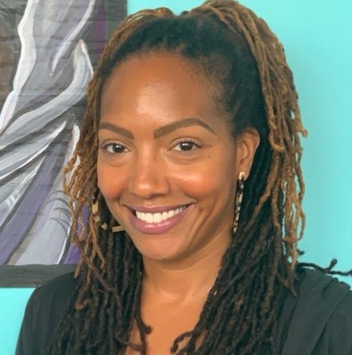
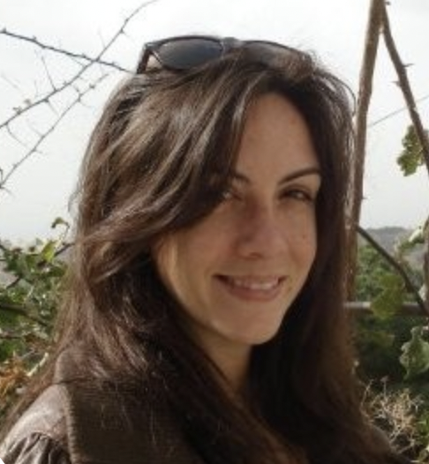
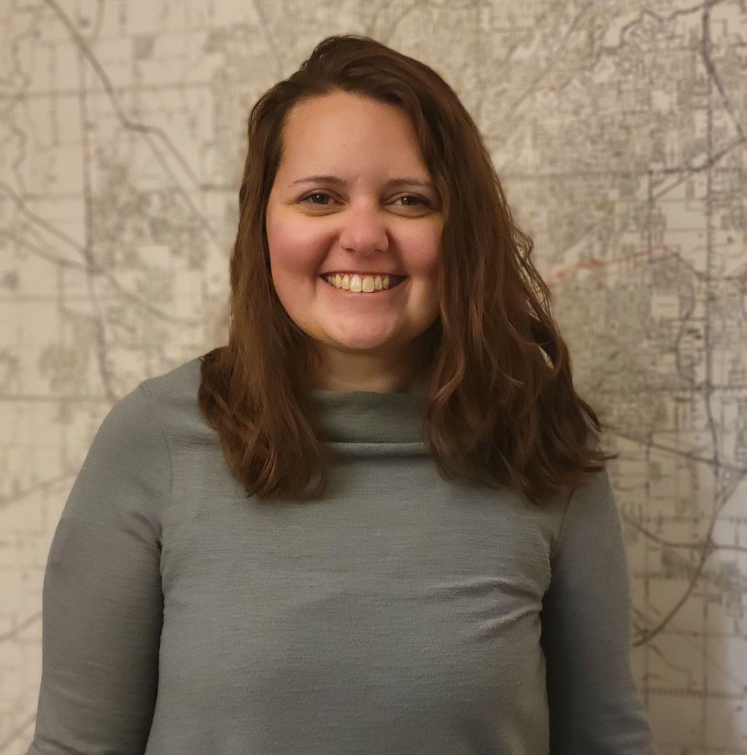
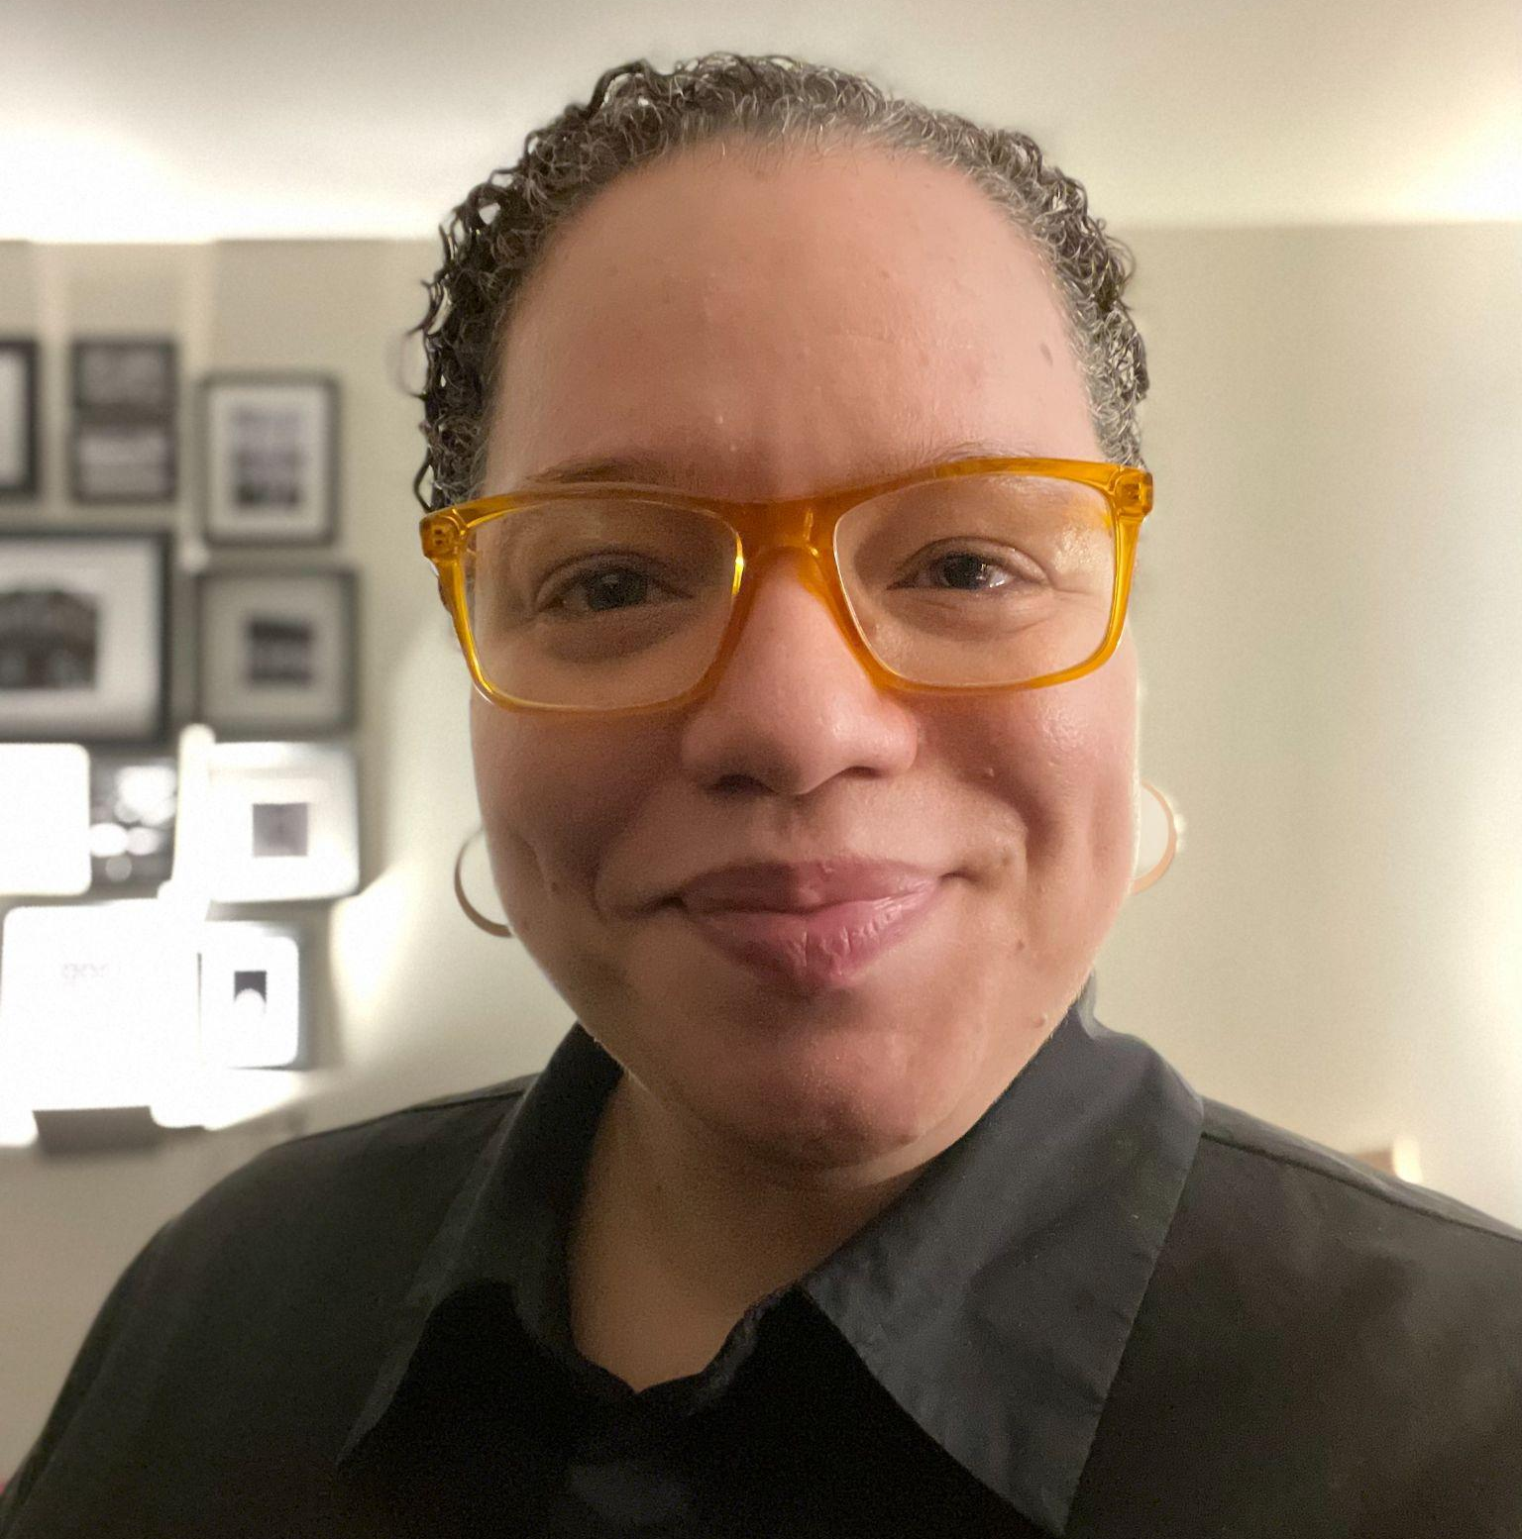
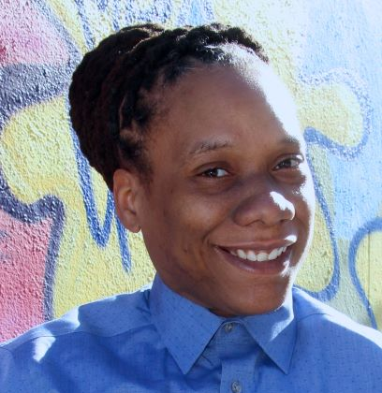

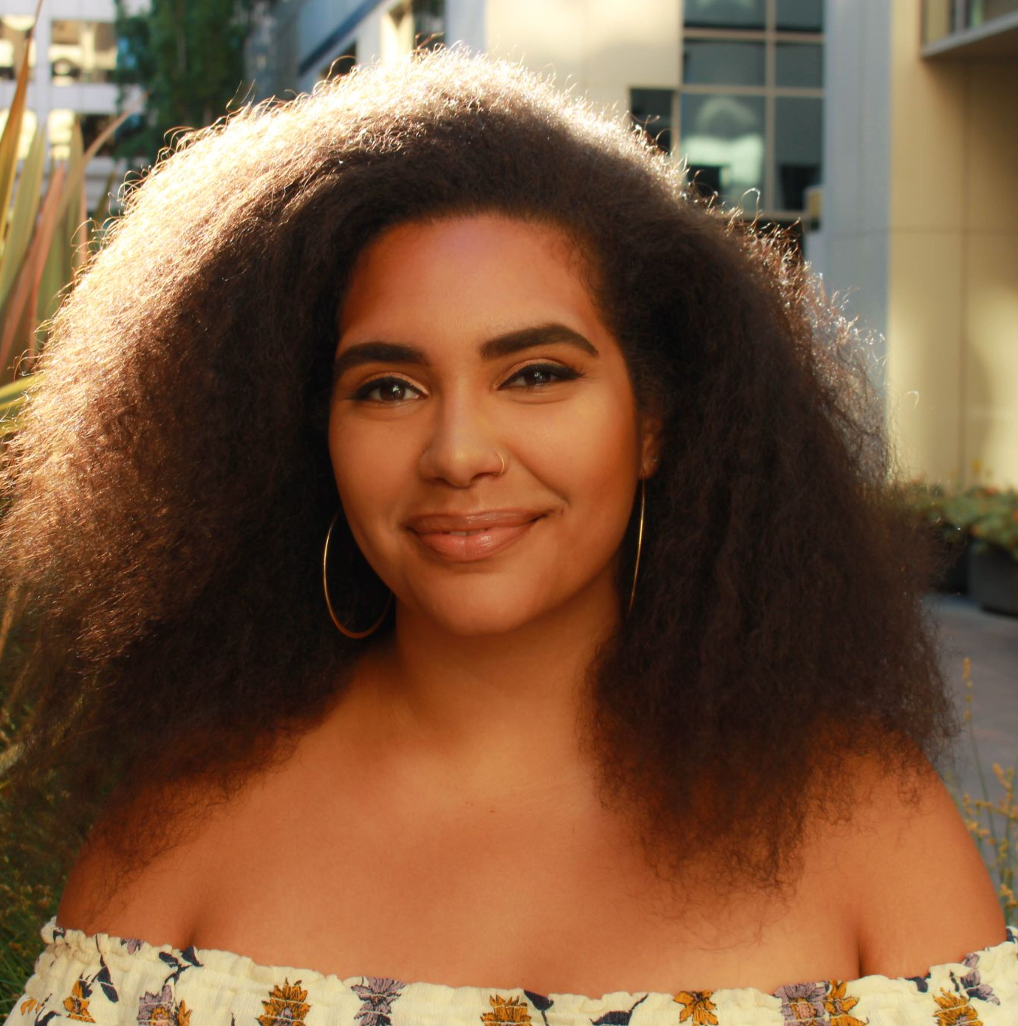
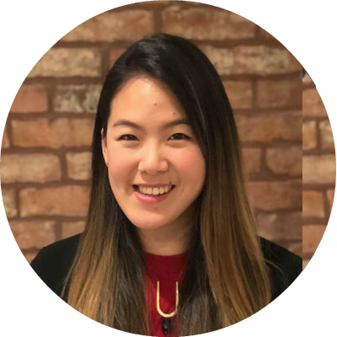
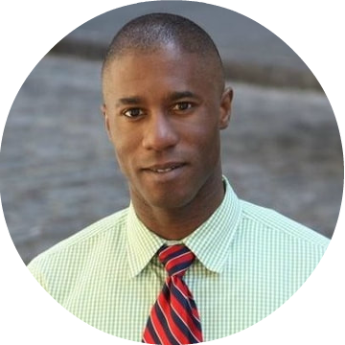
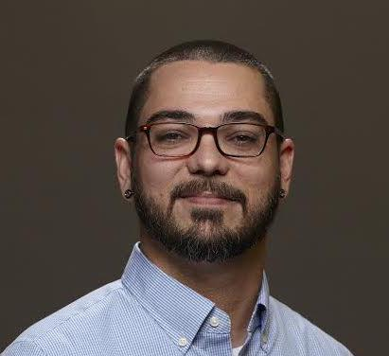

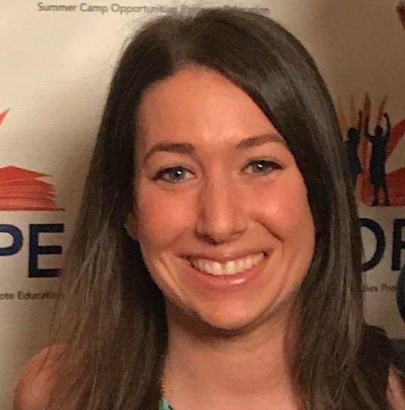
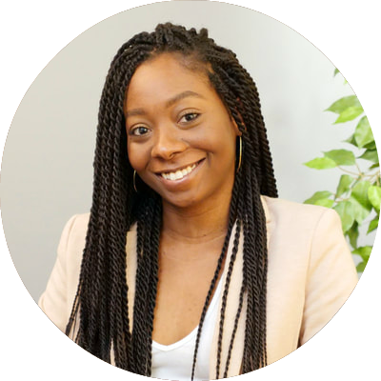
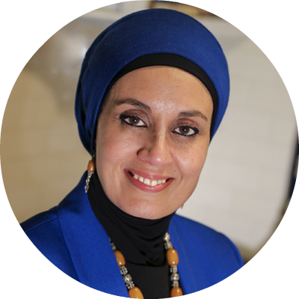
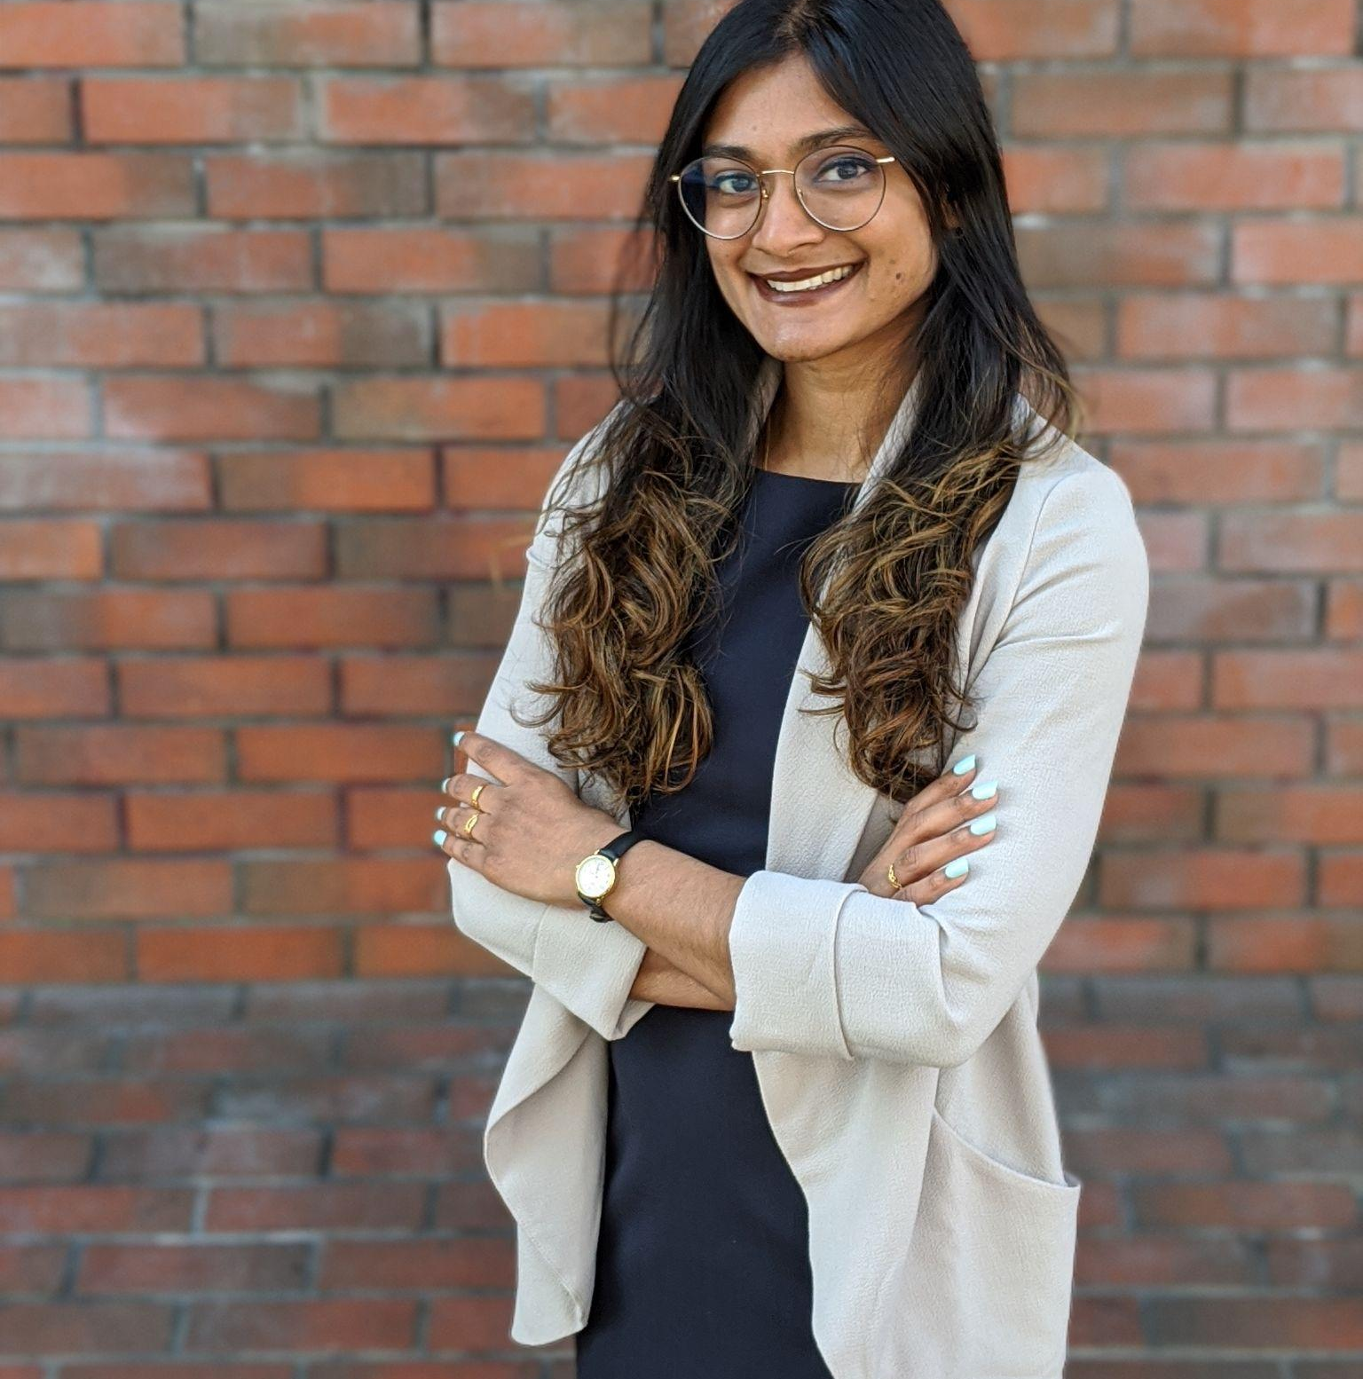
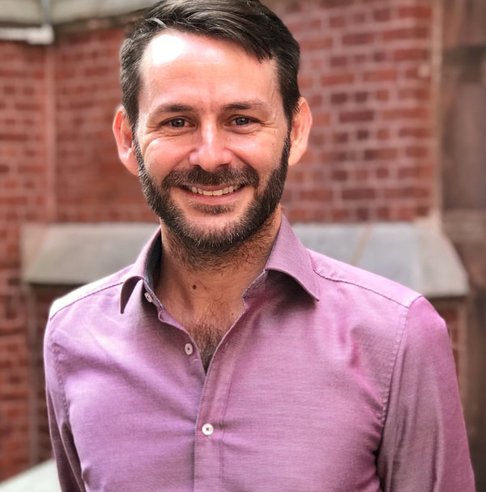

helps social impact nonprofits and schools to achieve results + advance equity.
Notes:
Brief origin story
Quick talking points for facilitators: Change Impact is a team of facilitators, consultants, and educators partnering with social impact organizations and schools to achieve results and advance equity. We know you all do amazing work in your communities, and we’re glad to be a part of it.
Change Impact offers: Quality Services, On-Demand
Tailored Solutions Across Sectors: Change Impact partners with a wide range of mission-driven organizations, from small nonprofits to universities and government agencies, offering scalable services that meet diverse needs.
Strategic HR Support: Change Impact fills human capital gaps by offering talent management solutions, including overseeing HR, payroll, and benefits administration.
Human Resources Outsourcing: Full-service HR management, payroll, and employee support services for streamlined operations.
Leadership Development: In-person and self-paced training for leadership, customized to partner organizations.
DEI Audits: Comprehensive diversity, equity, and inclusion assessments for youth-serving organizations.
Comprehensive Grant Support: Extensive experience in grant research, proposal writing, and copy editing.
Grant Writing and Evaluation: Expertise in writing grant proposals and evaluating publicly funded programs for continuous improvement.
Non-Financial Resources: Change Impact also helps secure critical resources such as technical assistance, space, and strategic partnerships that enable organizations to thrive.
Strategy Support: Tailored strategic planning strategies for achieving organizational goals, with processes that respect stakeholder time and expertise.
Data-Driven Evaluations: Support in developing logic models, evaluating program quality, and creating continuous improvement plans.
Data Training: Workforce development agencies are trained to leverage data for job readiness.
Design and capacity-building services: Support large or growing youth development programs with strategy and long term planning support

Slide 4
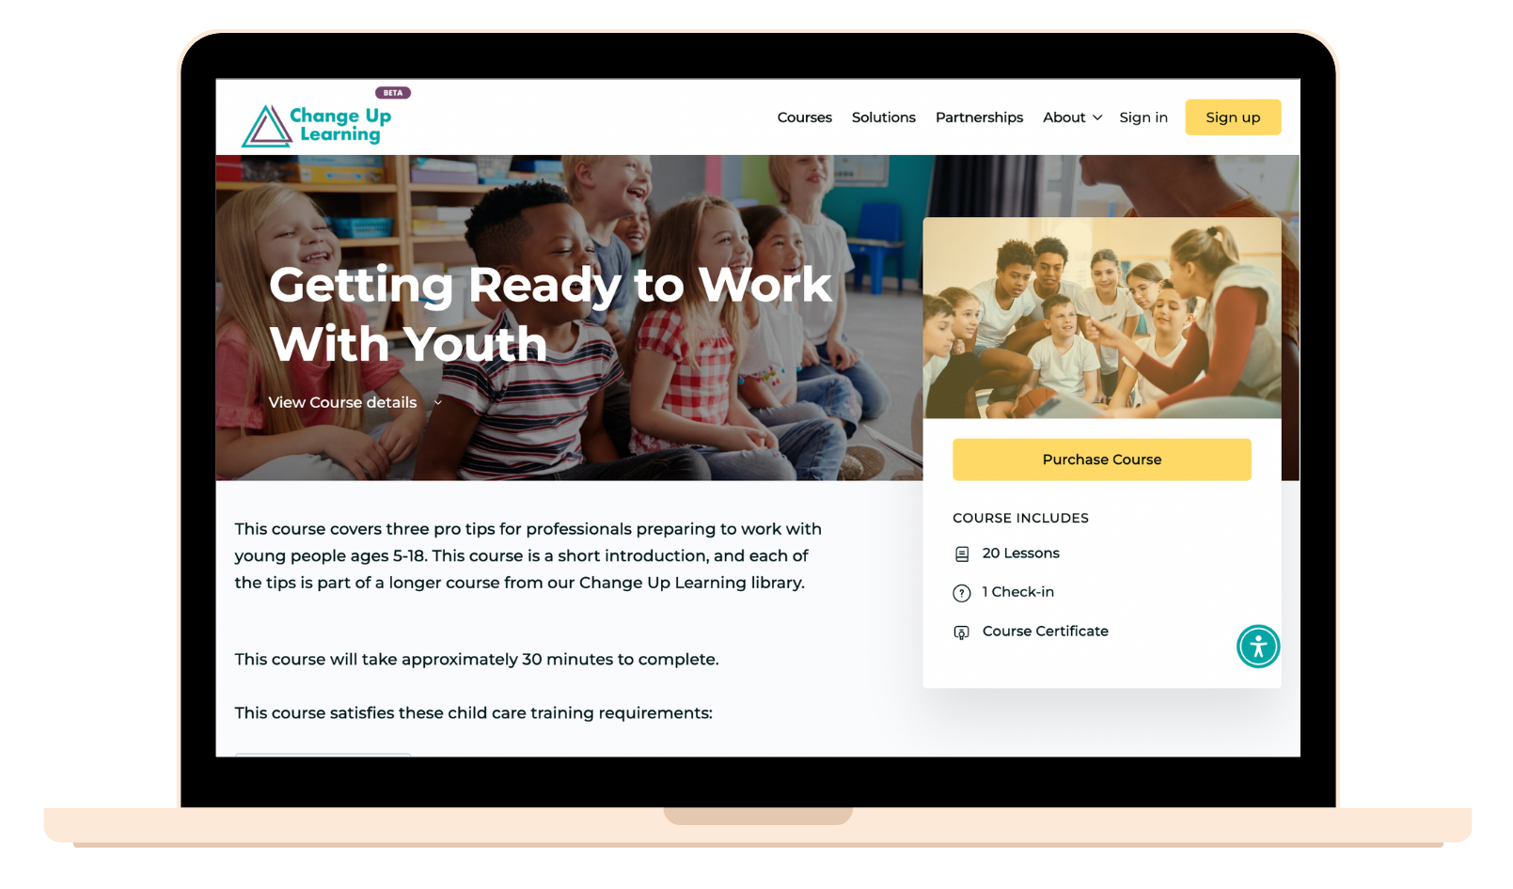
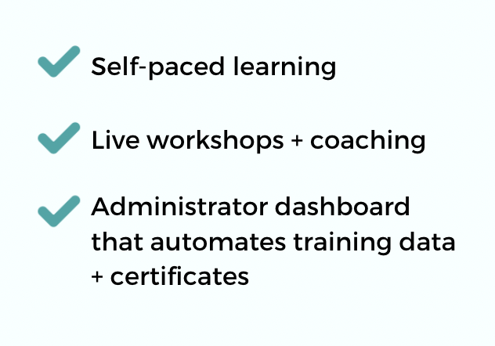
Change Impact powers Change Up Learning, an online PD platform for youth development professionals
www.changeuplearning.com
Notes:
Change Impact is the team behind Change Up Learning, an online PD platform for youth development professionals. Our asynchronous courses focus on working with and supporting youth and staff members.

Slide 5
Session Goals
Reflect on your vision for youth programming
Discuss promising practices to engage youth and families
Share resources to promote quality program implementation

Slide 6
Agenda
Welcome and warm up
Visioning for the year ahead
Interactive program possibilities
Planning & documentation best practices
Closing and evaluation

Slide 7
Session Norms
Be present and engaged 🎁
Be respectful of yourself, others, and the space ✌️
Feel encouraged to speak “in draft” (skip the sorry) 🗣️
Assume best intentions while centering impact - lean into grace and growth 🌱
Come as you are and take what you need ✨
What else? ➕

Slide 8
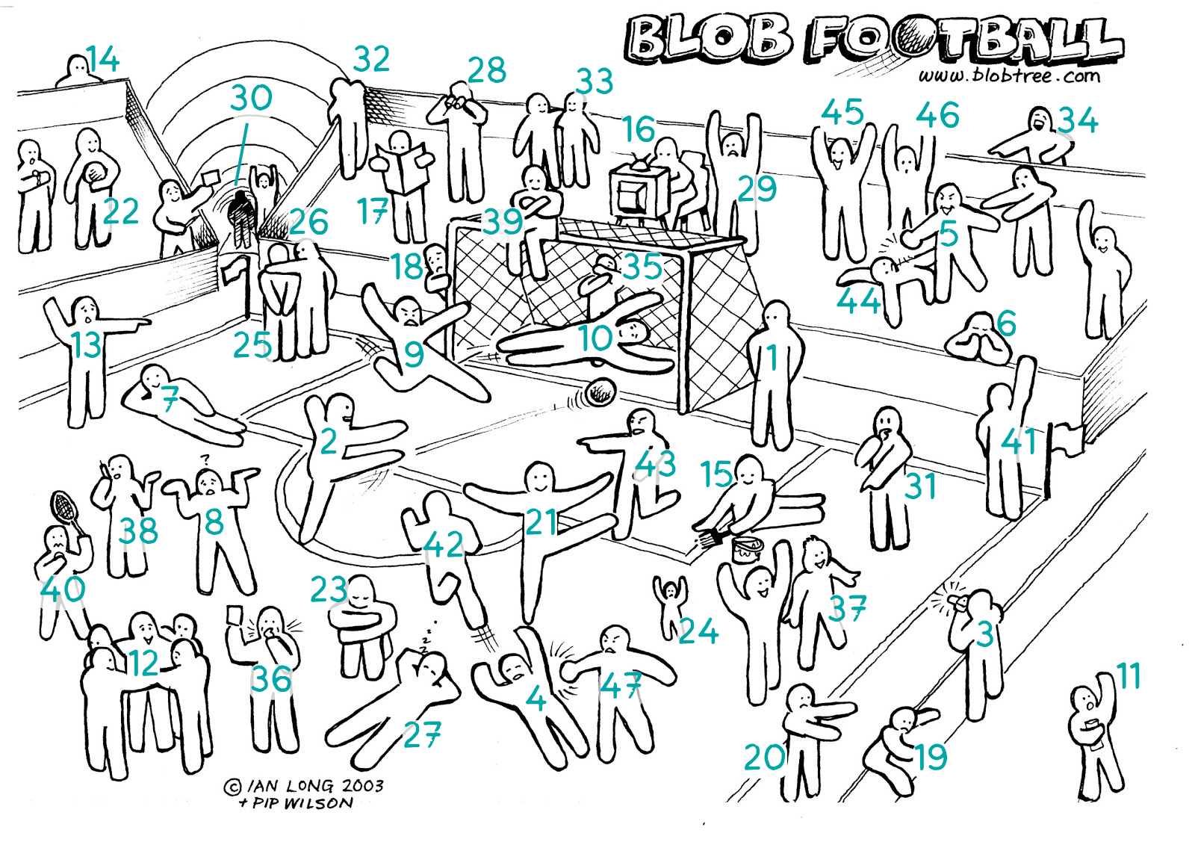
Warm Up!
Which blob person best describes how you’re feeling right now?

Slide 9
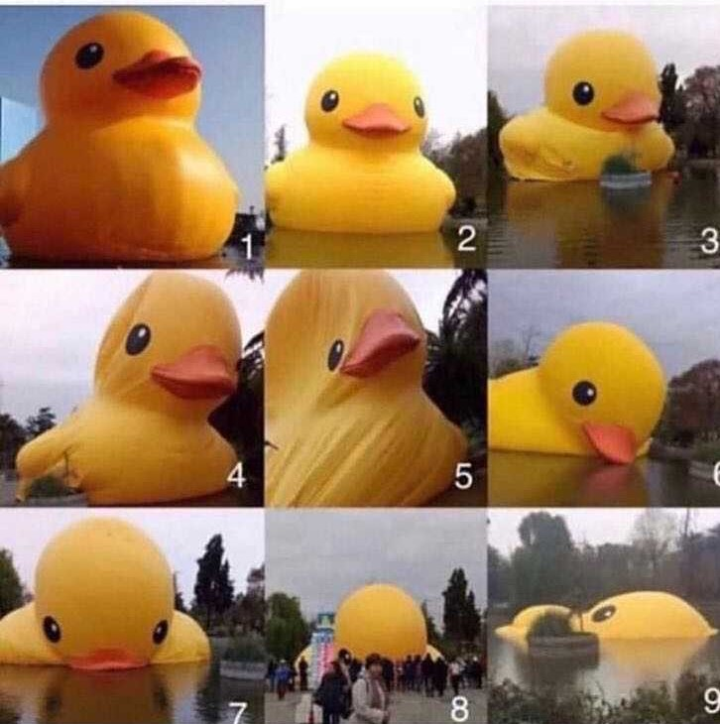
Warm Up!
Which rubber ducky best describes how you’re feeling right now?

Slide 10

Group Intros
Introduce yourself
Share which number represents your vibe today
Share what’s lifting you up or draining your energy
Notes:
8 mins (groups of 3-4)
In groups:
Introduce yourself - name, role, program, pronouns (optional)
Share which BLOB number represents your vibe today
Share what’s lifting you up or draining your energy

Slide 11
Your Vision for 2025-26
Notes:
10 mins

Slide 12


Thriving Ecosystems
Notes:
21CCLC programs are similar to ecosystems with their own climates, cultures, pathways, and stakeholders. When our ecosystems thrive, they generate creativity, light, expansion, stability, love, and more!

Slide 13
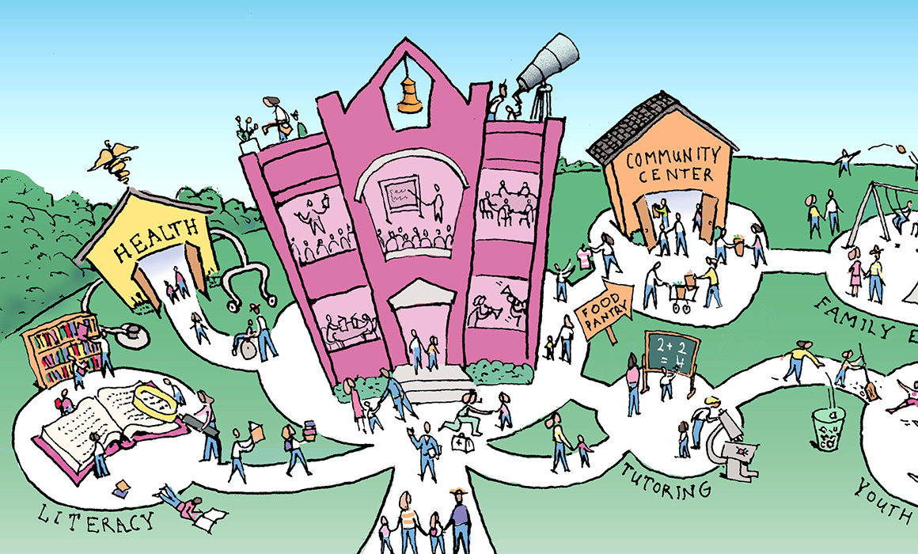
When my program thrives…
What do you want your program to look, sound, and feel like?
When you close your eyes or dream about the ideal youth development experience - what words or images come to mind?
Notes:
Creative, well-resourced, supportive spaces and systems help staff and participants thrive.

Slide 14
3 Tips for Interactive Programs
Notes:
20 mins
Culturally-responsive practice / planning (lean into youth interests, mindful of the current circumstances)
Using play as a tool for learning (PBL, gamify activities, power of social component in learning)
Field trips - connect with community partners, youth led initiatives, or build in research/discovery as part of choosing trips

Slide 15
Tip 1: Culturally-Responsive Practice
Believing that culture is not an addition but is a critical component of education.
Believing that students and their families are individuals with their own assets, knowledge, and abilities who should be valued and consulted.
Believing that critical and continuous self-reflection is required to dismantle systems of biases and inequities rooted in our country’s history, culture, and institutions.
NYSED Culturally-Responsive and Sustaining Education Framework
Notes:
Our source here is Zaretta Hammond and her work is titled Culturally Responsive Teaching and the Brain. Ideally, CRP combines these three critical components to enhance independent learning for agency.

Slide 16
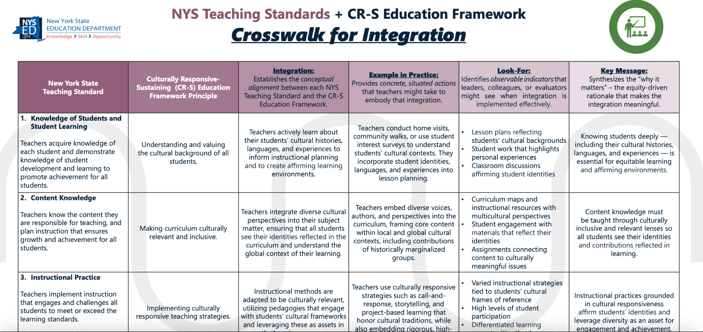
Crosswalk for Integration
Resource
Notes:
The TARC recently shared the NYS Teaching Standards + CR-S Education Framework Crosswalk for Integration, which includes examples of observable indicators that teachers, leaders, colleagues, or evaluators might see when integration is implemented intentionally, along with the equity-driven rationale that underpins and gives meaning to the integration.

Slide 17
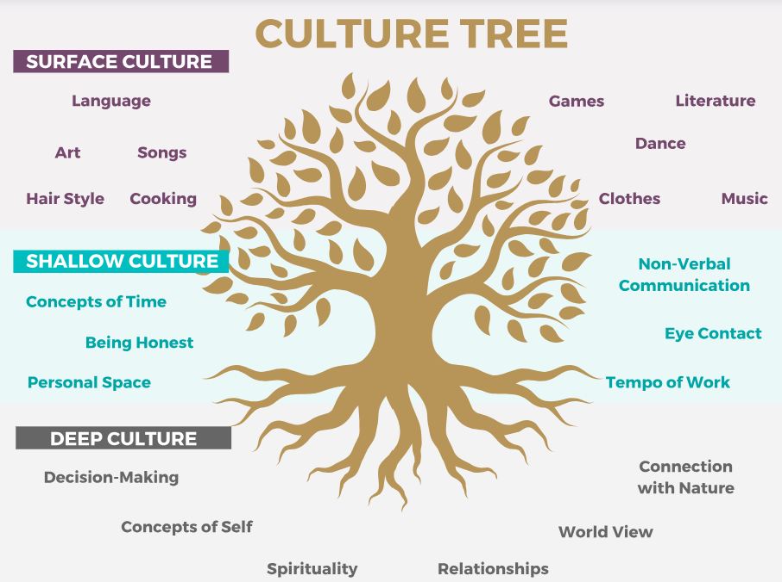
Building Trust with Students & Families
Surface Culture: This refers to the observable and tangible aspects of culture, such as clothing, food, music, and language.
Shallow Culture: This level goes beyond the surface and includes the unspoken rules and norms that guide social interactions and communication within a culture.
Deep Culture: This level is the most complex and includes the underlying beliefs, values, and assumptions that shape a person’s worldview.
Notes:
It’s important to recognize and respect the different layers of culture at play within your programs and communities. Ex: avoid planning meetings or events during cultural holidays; recognize that some family structures (point of contact) differ from your own

Slide 18

Who Am I?
Over the next 5 minutes, start to craft your
Who Am I poem.
The rules?
Every line starts with “I am…”. That’s it!
Notes:
Share as a resource
2:50-2:55 - share (anyone who wants to) and debrief (how did this activity make you feel?)

Slide 19
Tip 2: Use Play As A Learning Tool
Simple games like freeze dance or “I Spy”
  ages 4-7 learn quickly
  executive function, self-regulation, and physical skills at their own pace
Puzzles, word games, and fantasy games help kids
  ages 8-12 build memory skills
  develop mental flexibility
Source: Harvard’s Center on the Developing Child

Slide 20
Tip 2: Use Play As A Learning Tool
Group play involving instruments, singing and dancing, theater, and organized sports
  ages 13-17
  supports self-regulation and a sense of belonging
Source: Harvard’s Center on the Developing Child

Slide 21

Game Play in Learning
Each person has numbers 1-5 written on individual pieces of paper (index cards/post-its/using hands).
The facilitator calls out an equation.
Each participant has to hold up the correct answer as quickly as possible.
*Variations: continents, parts of speech, food groups, animal types, etc.
Ex: Number-grams
Notes:
Ex: What is 20 divided by 4? The group has to show 5 on their hand.
Quick interactive tangible way to review material (again with each person creating or having their own set of materials)

Slide 22
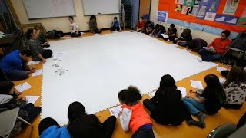
Lift Up Play, Process, and Reflection
Notes:
1:50
https://youtu.be/KNR9pUgjFDA

Slide 23
Project Based Learning
A student-centered method of instruction centered on active exploration of real-world challenges and problems.
Emphasizes process over product
Involves inquiry, research and investigation, student choice, and reflection
Project example: High Tech High students set out to discover how disability and technology intersect.

Slide 24

SEL <> Gamified
Identify 4 corners of the room
Everyone starts in corner # 1
Advance to the next corner (moving around the room), by winning a round of Rock-Paper-Scissors
Your goal: make your way around the room as many times as you can in 3 minutes!
Notes:
If time and space allows, play this game as a way to turn a traditional fun enrichment activity into an opportunity to discuss SEL..
“RPS Around the World” - this is a variation on Rock Paper Scissor, that can incorporate SEL competencies.
(Self awareness, responsible decision making)
Reflection questions after the game can also be a way to infuse SEL in youth programs
What did you like about the game? What was challenging? Name a feeling that you experienced in those 3 minutes. How could we turn this game into something related to science or international cuisine? (or topic/content that is relevant for the age group)

Slide 25
Tip 3: Bring Field Trips Into Focus
Reflected in our approved budget
Completed NYSED Field Trip Form at least 30 days in advance
Considered reasonable and necessary
Has an educational focus
Transportation and food costs are reasonable
Lesson plan to accompany and guide the experience
Inclusive of student interests
Not offered as an incentive or reward to some students
NYSED field trip guidance and forms

Slide 26
Planning & Documentation Best Practices
Notes:
15 mins

Slide 27
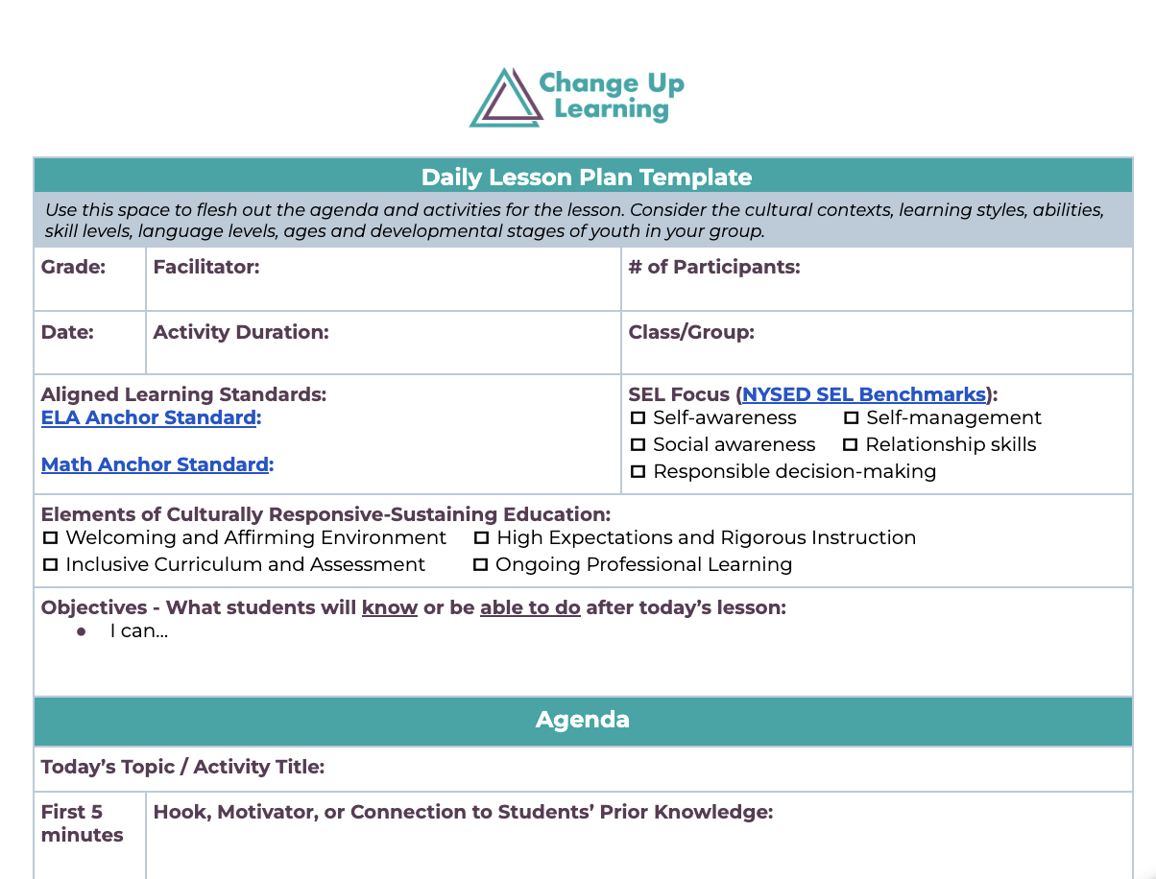
Daily Activity Plans
Lesson Plan Template
Notes:
Many of you have lesson plan or activity planning tools - but do they align with your vision for your program?

Slide 28
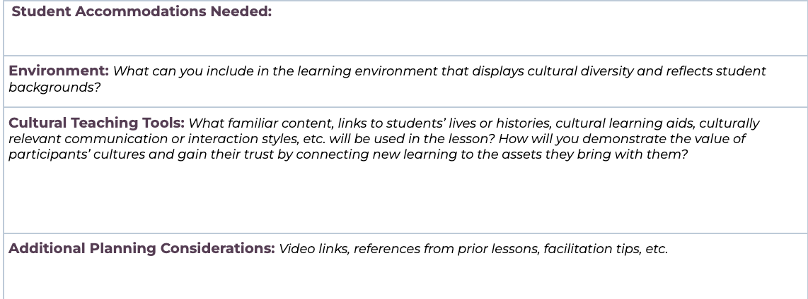
Get Specific
Lesson Plan Template
Notes:
Many of you have lesson plan or activity planning tools - but do they align with your vision for your program?

Slide 29
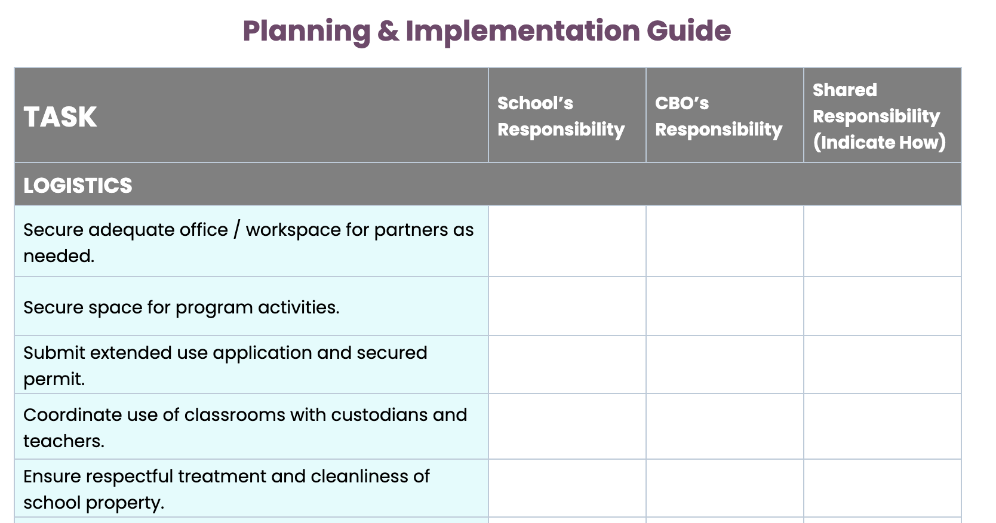
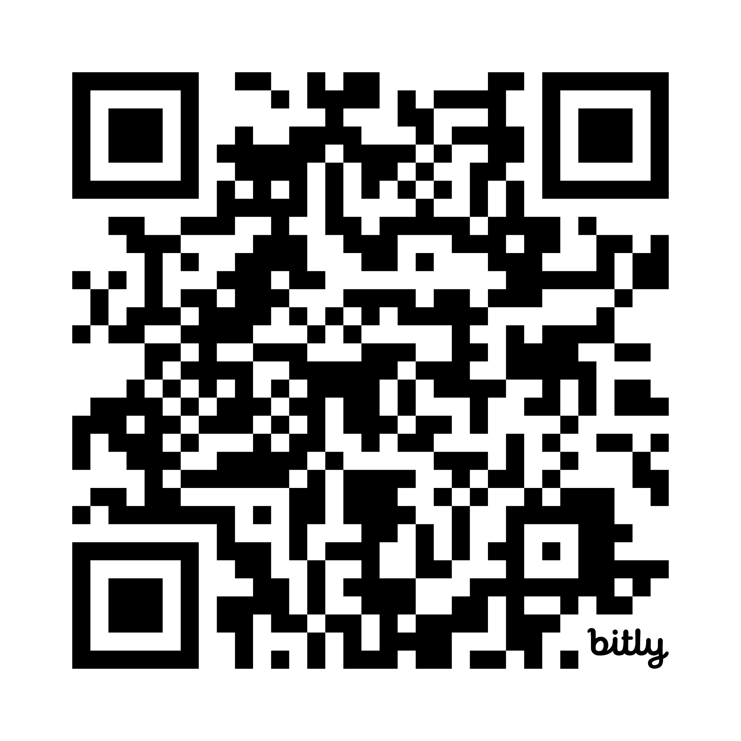
OST Implementation Guide
Logistics
Safety
Staffing
Programming
Recruitment
Data Management
Quality Assurance
Notes:
Do you use a tool like this currently? Is there anything you might add or change?
https://docs.google.com/document/d/1D0ykchPcByfMVqVod-DcMZfa1325E2HK/edit
With this sample, note that timing is included in the plan. How often do you want to collect data? What’s realistic for your audiences? Is paper or online feedback the best case scenario?

Slide 30
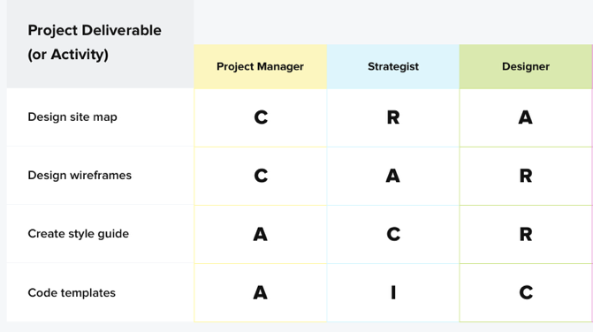
Tool: RACI Matrix to Establish Roles
Responsible: Does the work to complete the task
Accountable: Delegates the work and provides final review
Consulted: Provide input based on expertise/role
Informed: Kept in the loop
Create staffing strategy
Develop orientation
program
Budget development
Write grant report
Notes:
A helpful resource for project management. Is there a task or event that feels like a super complex project? For example: consider using this for your end-of-year celebration.

Slide 31
21CCLC Documentation Library
SMV Report
Afterschool 21 trainings from June: Part 1 and Part 2
Quality Self Assessment Tool
Sample meeting agenda
Notes:
Darise
https://docs.google.com/document/d/18YIv4vcLEywDXxF4kPcEVg0W6L2hJPpQ/edit

Slide 32

8 Collaborative Planning Strategies
Co-create community agreements
Define goals and clarify expectations
Utilize planning tools like RACI
Establish a regular meeting schedule
Align your language
Debrief milestones
Celebrate successes
Invite formal and informal feedback
Notes:
Collaborative planning is a multi-step process.

Slide 33
Turn & Talk
Take 2 minutes to consider which program practice or resource you want to explore more
Share ideas with your partner!
Notes:
2 minutes of quiet reflection

Slide 34
Closing and Evaluation

Slide 35

Follow up!
Keep an eye out for these slides and a friendly reminder to try out what you learned!
Notes:
Communication about 2024 cohorts/dates coming soon!

Slide 36

Looking Ahead
Which practice, strategy, or resource would you like to try?
With whom do you want to share these ideas?
Notes:
https://changeuplearning.com/ros-tarc
https://changeuplearning.com/nyc-tarc

Slide 37

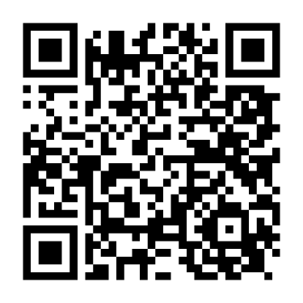
Looking for even more
fun facts, videos, inspirational quotes and good vibes?
changeuplearning
Follow us on the ‘Gram!
Scan me!
@changeuplearning

Slide 38
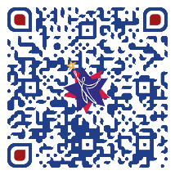
Thank you!
Please take a moment to complete the survey.
Open your smartphone’s camera app and aim at the code!

