Slide 1



PREPARING FOR YOUR SMV
September 19th, 2025
Presented by:
21st CCLC ROS Technical Assistance Center

Slide 2

Purpose of the SMV Key Components of the SMV Resources on the ROS TARC website Overview of NYSED Action Plan Agreement Who should be present for the SMV Q & A
Agenda
Notes:
Objective: help you become more familiar with tool and what is required.

Slide 3




Purpose:
What was the most challenging thing for you while preparing for your upcoming SMV?
COMPLIANCE
QUALITY
SHOWCASE
IMPROVEMENT
Ensure that our programs are providing high quality services to students and families
Verify that programs are in compliance with Federal & State regulations and requirements
Provide an opportunity for programs to showcase their exceptional staff & students
Assess possible areas for improvement

Slide 4

Key Components of the SMV Process
Pre-Visit Preparation:
The TARC chooses a site
Document review and preparation
Scheduling and agenda setting
Day of Visit:
Document review session
Program walk-through and observations
On-site support and feedback
Post-Visit:
Final SMV report submission
Development and monitoring of action plans
Action plan items can be worked on for up to 6 months after the visit.
Did you both feel adequately prepared for the SMV?

Slide 5

Prepare by Reading and Asking Questions!
Make sure you read and understand:
SMV Tool
Action Plan Agreement
Round 8 Request for Proposals
Program Director’s Manual
Your organization’s application and narrative
Always Ask Questions!
What was the overall
experience like for you?

Slide 6
Site Monitoring Visit & SMV Resources
Located on the ROS TARC website: https://www.nys21cclc.org/site-monitoring-visit
SMV and TA Visit Documents
Post SMV Reflections
  If your program participates in an Site Monitoring Visit (SMV) from July 1, 2025 to June 30, 2026 and you would like to provide feedback about your SMV experience, please use the Post-SMV survey link to access the form.
  The information you provide will help us understand which parts of the SMV process work well and where it can be improved! Any questions related to this survey should be directed to Measurement Incorporated.
Round 8 Site Monitoring Visit Report Template (Reformatted 12/19/24)
Action Plan Agreement Template
Site Monitoring Visits and Action Plan Fact Sheet
Glossary for the Site Monitoring Visit Tool
Technical Assistance Site Visit Template
Round 8 Welcome Visit Tool (Updated Aug 2023)
Did either of you use these resources before you met with the ROS TARC staff for your SMV?

Slide 7
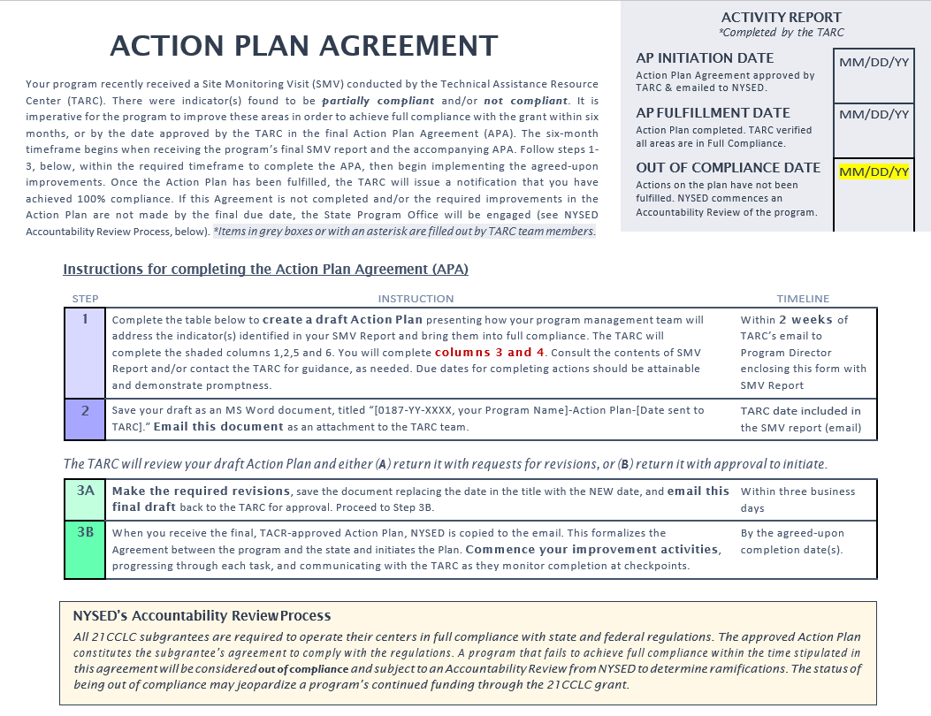
Did you end up having an Action Plan Agreement?

Slide 8
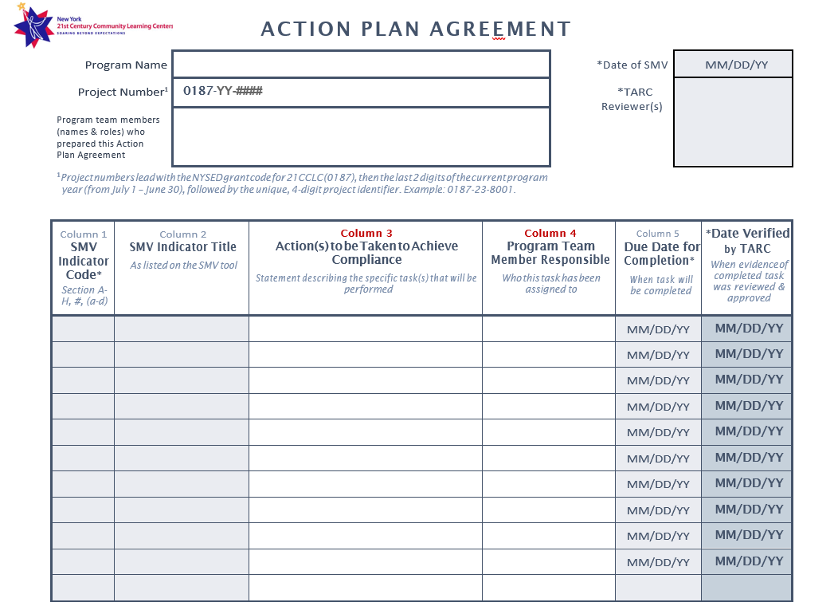

Slide 9

Who needs to be at the visit?
Who did you have present at your SMV document review?
Program Director
Sections A, B, D, E, F, G
Fiscal Coordinator
Section C
Evaluator
Sections G & H
NYSED Staff & School Admin
May attend at their discretion

Slide 10

The SMV is NOT:
To catch your program doing something wrong
To come unannounced
To leave you without resources or support
What ways do you think the SMV process could be improved upon
in the future?

Slide 11


HAVE A QUESTION?
Question and Answer Time
REST OF STATE
‘25
Fall Conference

Slide 12
There will be an upcoming Town Hall on Oct 7th and 8th from 1 – 2pm
Please join us for a more
in-depth review of the
entire SMV process

Slide 13
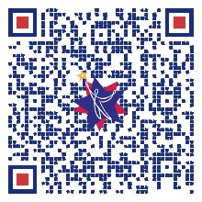
THANK YOU!
Please take a moment to complete this short survey and provide your feedback.

